Slide 1
Thrombus mechanics: from microstructure and mechanical testing to imaging and device design
Frank Gijsen
Department of Biomechanical Engineering, TUDelft
Department of Cardiology, ErasmusMC

Slide 2
The clinical problem: stroke

Slide 3
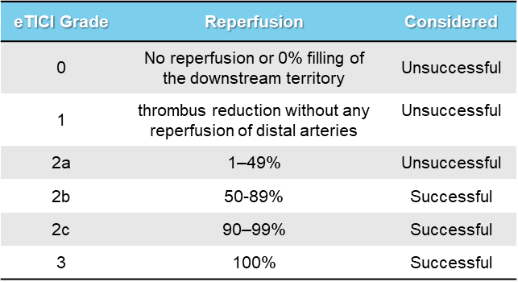
The preferred treatment: thrombectomy
34-41%
Liebeskind et al. JNIS (2019)
Jansen et al. BMJ Online (2018) / Compogne et al. Stroke (2022)

Slide 4
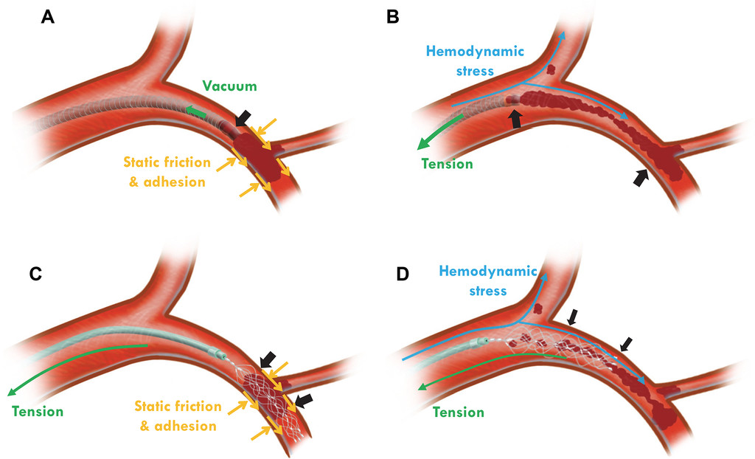
Mechanical forces acting on a thrombus
Liu et al. JNIS (2020)

Slide 5
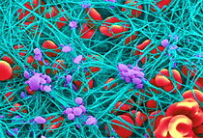
What determines thrombus mechanics?
Red Blood Cells
Fibrin fibre
Platelet

Slide 6
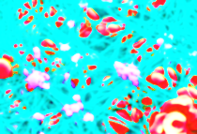
Topics:
How do thrombi from patients look?
Can we regenerate thrombi in-vitro?
How do we measure the mechanical properties?
Can we image the mechanical properties of thrombi?
How can we remove thrombi efficiently?

Slide 7
Topics:
How do thrombi from patients look?
Can we regenerate thrombi in-vitro?
How do we measure the mechanical properties?
Can we image the mechanical properties of thrombi?
How can we remove thrombi efficiently?

Slide 8
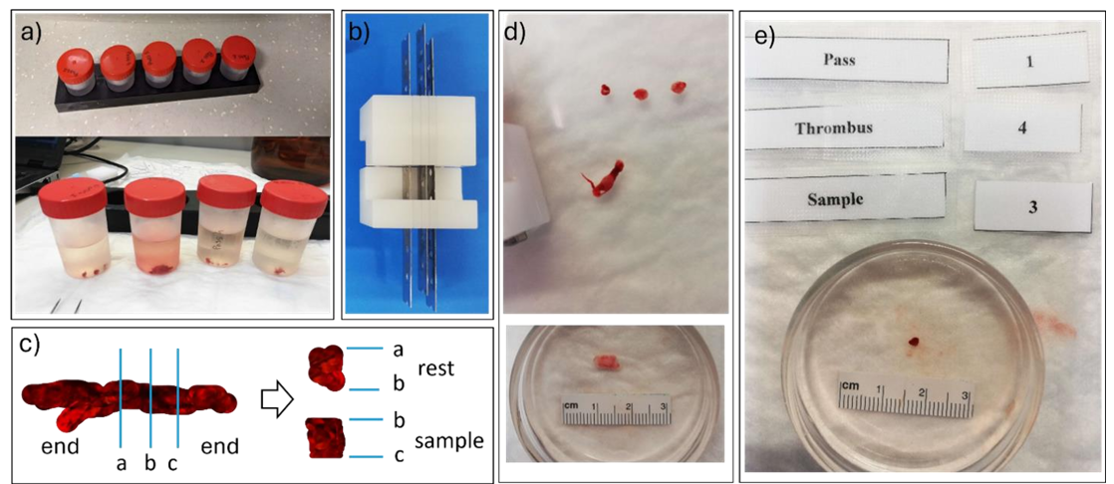
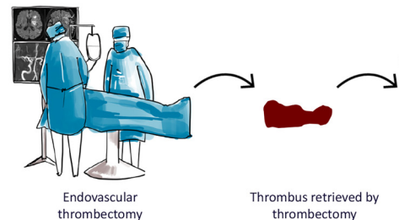
Composition of intracranial thrombi

Slide 9
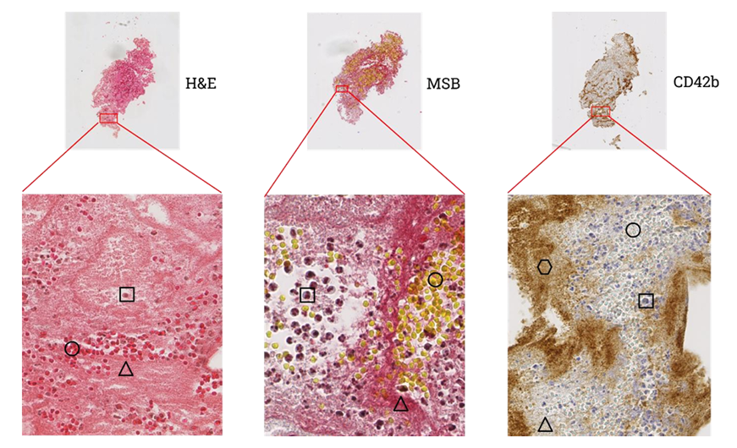
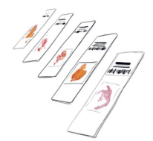
Composition of intracranial thrombi

Slide 10
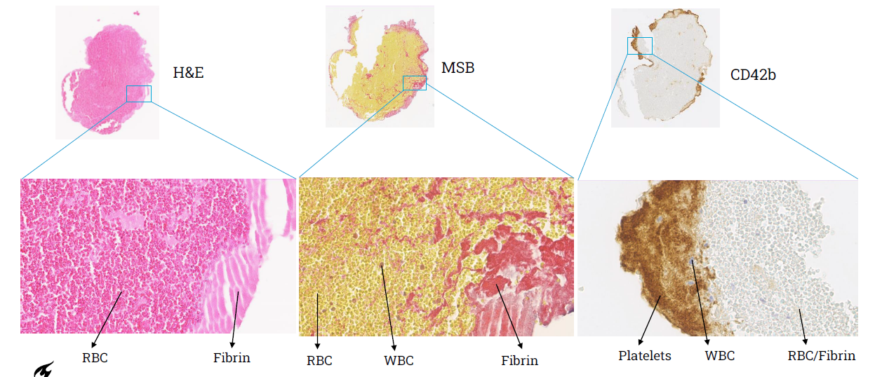
Composition of intracranial thrombi

Slide 11
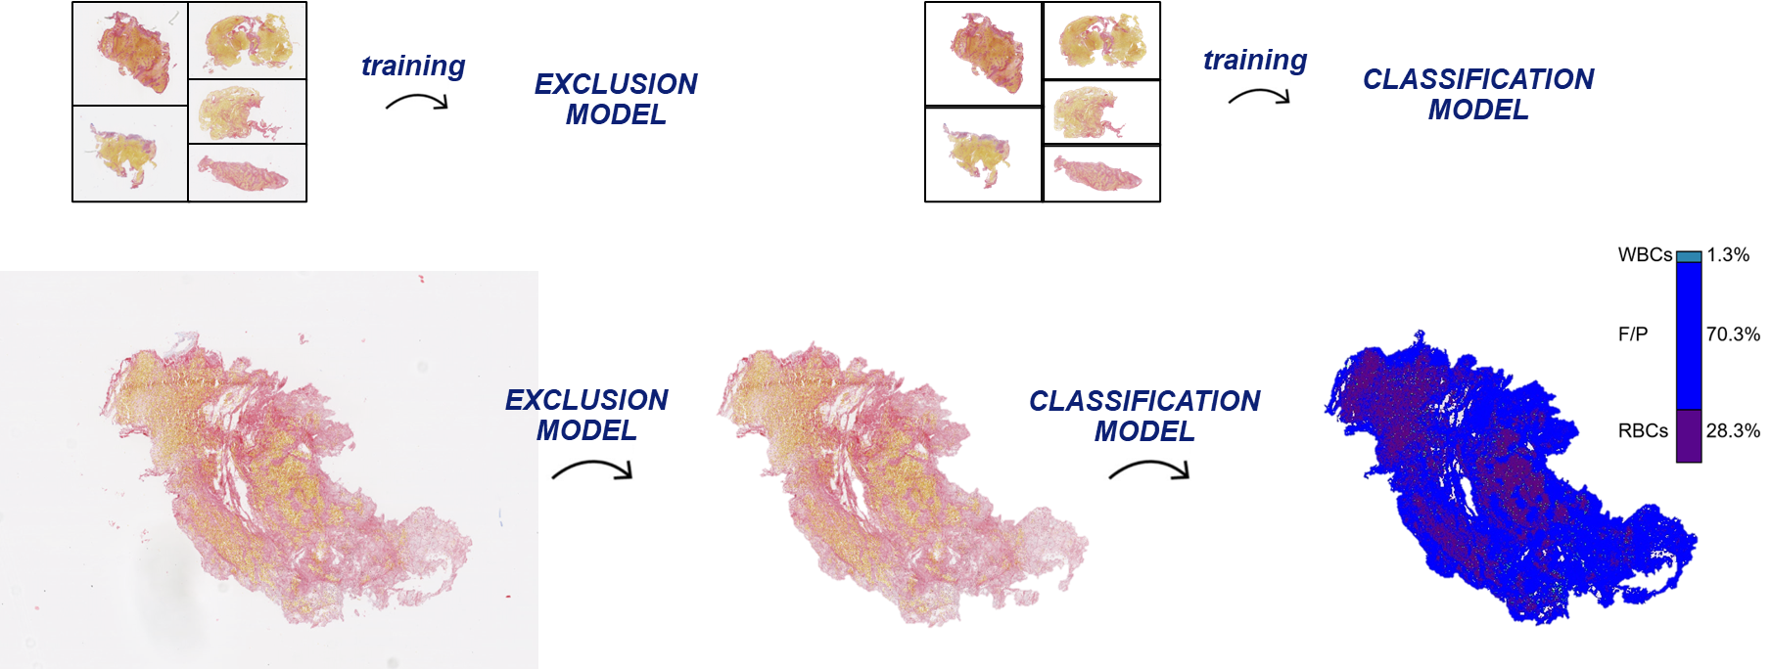
Composition of intracranial thrombi

Slide 12
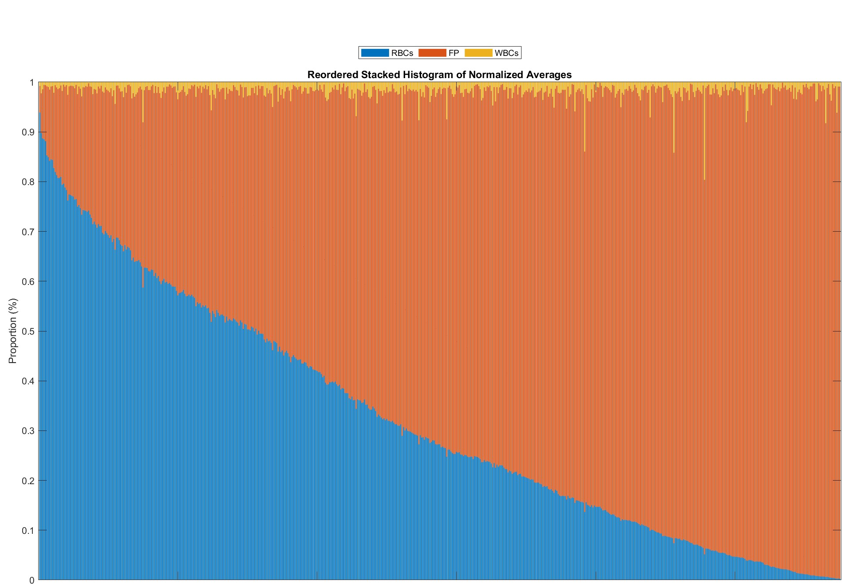
Composition of intracranial thrombi

Slide 13
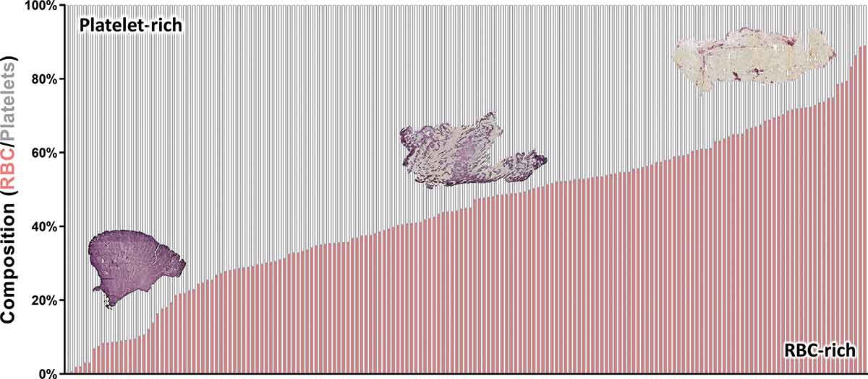
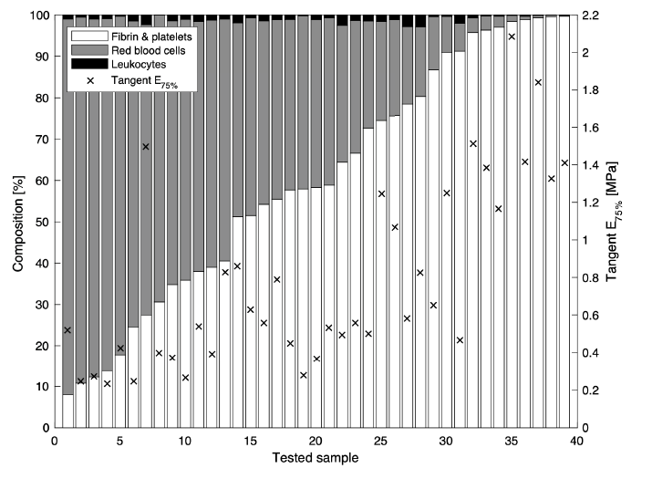
Composition of intracranial thrombi
Staessens et al. Platelets 32.3 (2021): 331-339.
Boodt et al., Stroke, 52.8: 2510-2517, 2021

Slide 14
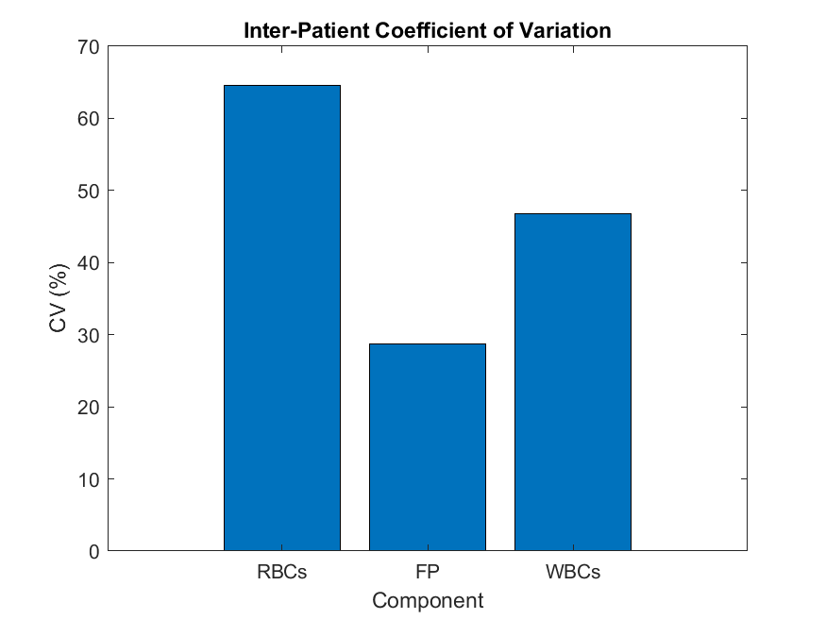
Composition of intracranial thrombi

Slide 15
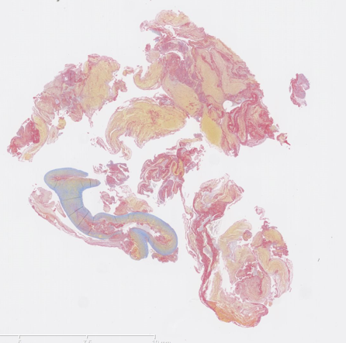
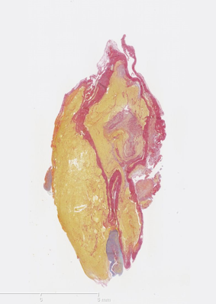
Composition of venous thrombi

Slide 16
Thrombus composition: take home message
AIS thrombi:
You can expect any average composition you can imagine
Very reproducible distribution (do not redo this, come to us, we will share the data if possible)
Histology reveals high cross-sectional heterogeneity
Histology reveals high intra-patient variability
DVT thrombi:
Much less studied
If anything, even more heterogeneous than AIS thrombi

Slide 17
Topics:
How do thrombi from patients look?
Can we regenerate thrombi in-vitro?
How do we measure the mechanical properties?
Can we image the mechanical properties of thrombi?
How can we remove thrombi efficiently?

Slide 18
(homogeneous) thrombus analogue generation
Whole Blood (WB)
120g
Platelet-rich plasma (PRP)
+ CaCl₂ and thrombin
2000g
RBCs
+
Platelet-poor plasma (PPP)

Slide 19
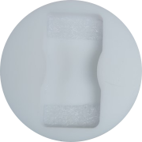
(homogeneous) thrombus analogue generation
PRP
5%
10%
20%
40%
60%
WB
PPP

Slide 20
(homogeneous) thrombus analogue generation

Slide 21
(homogeneous) thrombus analogue generation

Slide 22
(homogeneous) thrombus analogue generation
Cahaane et al., Annals of biomedical Engineering, 20204

Slide 23
(homogeneous) thrombus analogue generation
Unpublished data

Slide 24
(homogeneous) thrombus analogue generation
CV
CV
Unpublished data

Slide 25
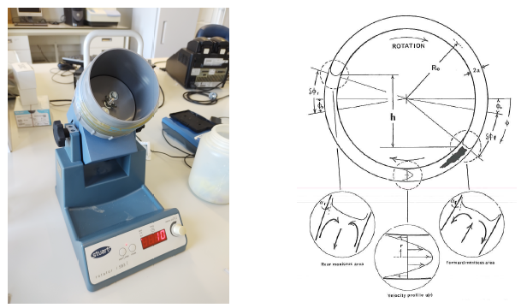
(heterogeneous) thrombus analogue generation
Unpublished data

Slide 26
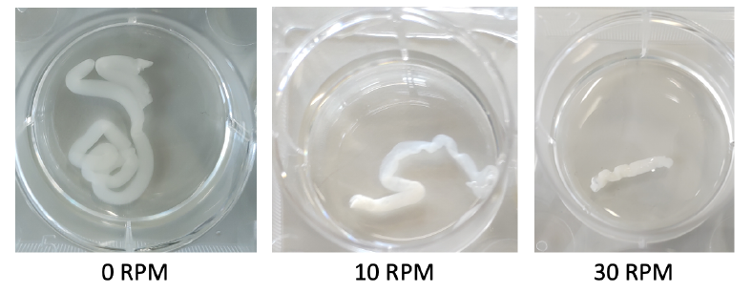
(heterogeneous) thrombus analogue generation
Unpublished data

Slide 27
(heterogeneous) thrombus analogue generation
Unpublished data

Slide 28
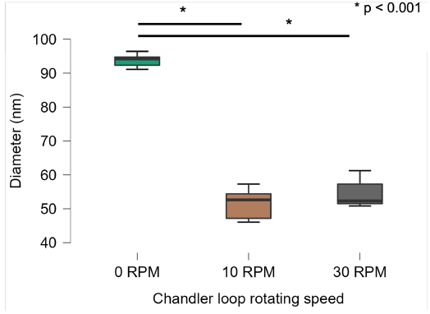
(heterogeneous) thrombus analogue generation
Unpublished data

Slide 29
Thrombus analogues: take home message
Homogeneous thrombi:
It is pretty straightforward to generate homogeneous thrombi
Rapid network formation makes it a bit more difficult to generate RBC-poor thrombi
The effect of platelet concentration on the final thrombus structure cannot be ignored
Heterogeneous thrombi:
No ‘accepted’ protocols available yet, especially for ‘older’ thrombi
Embrace the variation

Slide 30
Topics:
How do thrombi from patients look?
Can we regenerate thrombi in-vitro?
How do we measure the mechanical properties?
Can we image the mechanical properties of thrombi?
How can we remove thrombi efficiently?

Slide 31
Can we measure thrombus properties?

Slide 32
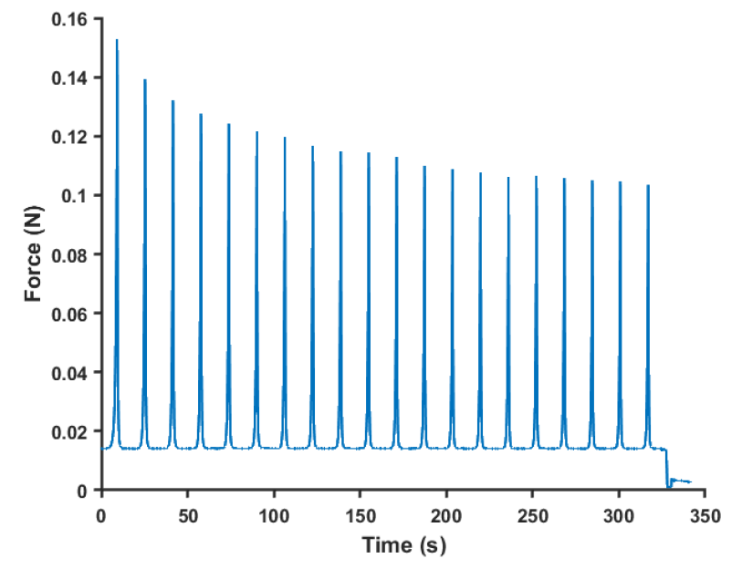
Can we measure thrombus properties?

Slide 33
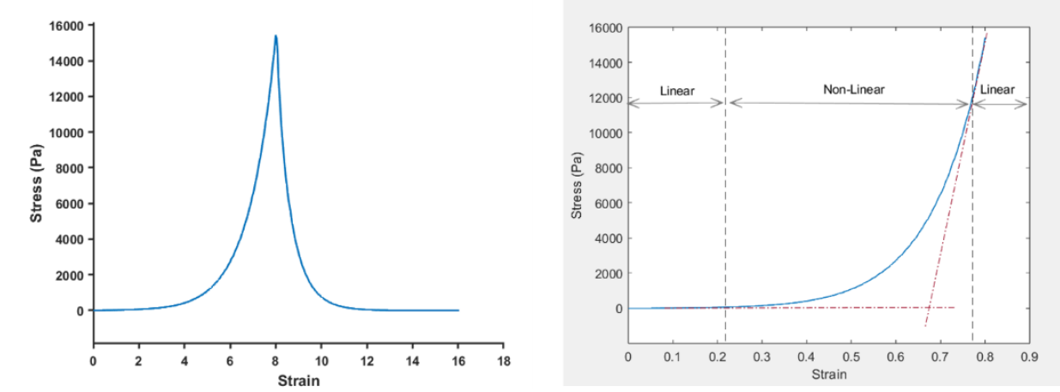
Can we measure thrombus properties?

Slide 34
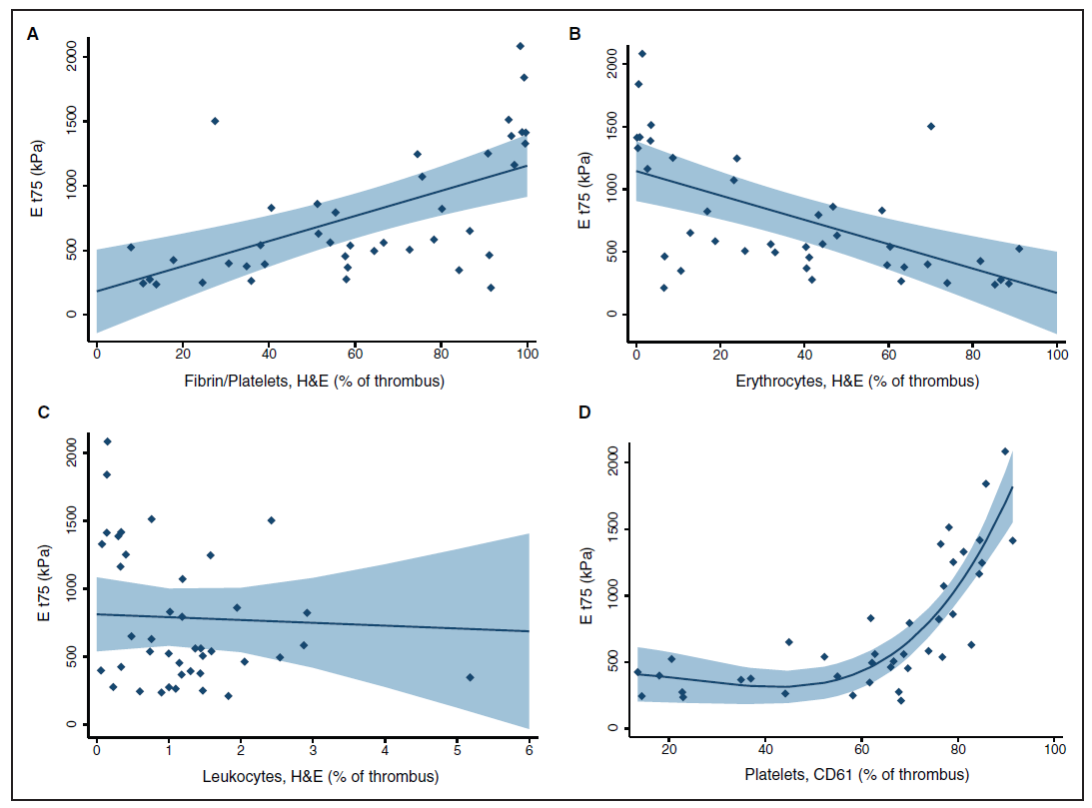
Data from patients

Slide 35
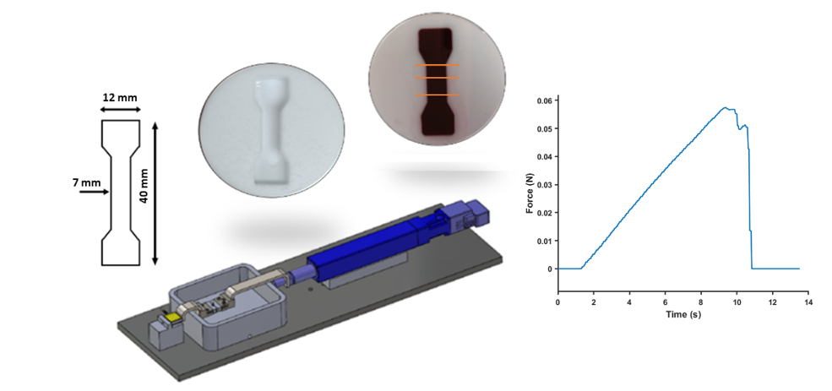
Can we measure thrombus properties?

Slide 36
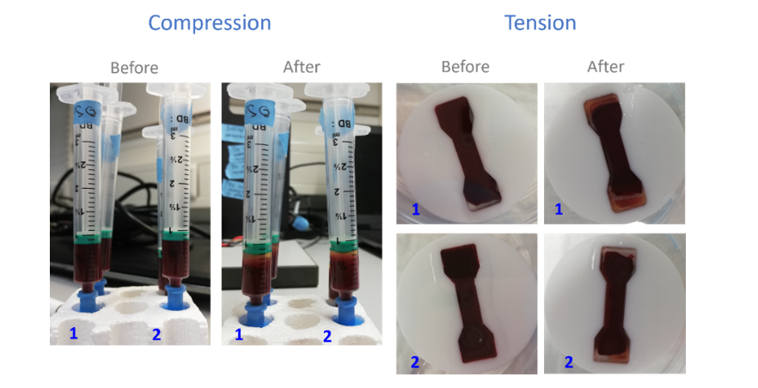
Can we accurately measure thrombus properties?

Slide 37
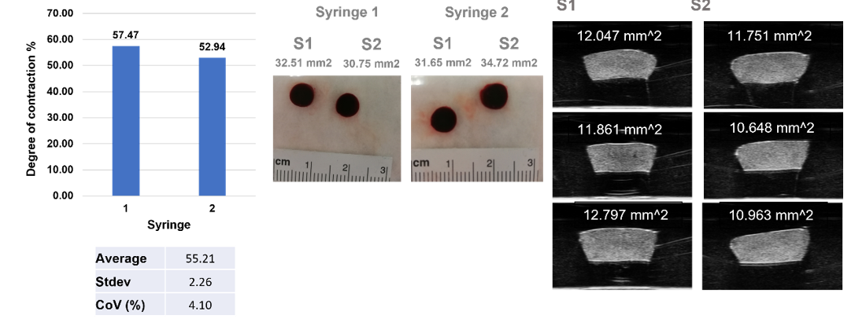
Can we accurately measure thrombus properties?

Slide 38
Can we accurately measure thrombus properties?

Slide 39
Data from thrombus analogues
Cahalane et al. Annals of Biomedical Engineering, (2023)

Slide 40
Data from thrombus analogues
Cahalane et al. Annals of Biomedical Engineering, (2023)

Slide 41
Mechanical properties: impact of RBC content
Cahalane et al. Annals of Biomedical Engineering, (2023)

Slide 42
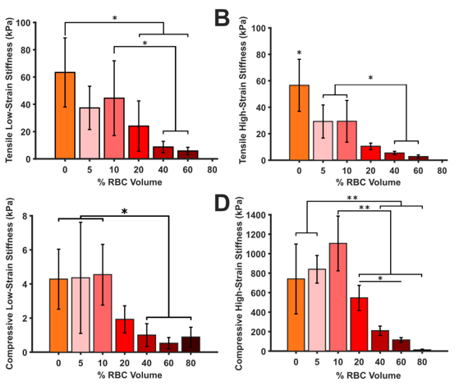
Mechanical properties: impact of RBC content
0%
10%
80%
Cahalane et al. Annals of Biomedical Engineering, (2023)
Notes:
0% no RBC, 10% tighly packes, polyhedrocytes, 80% less fibrin, more biconcave shape (less contractive forces?)

Slide 43
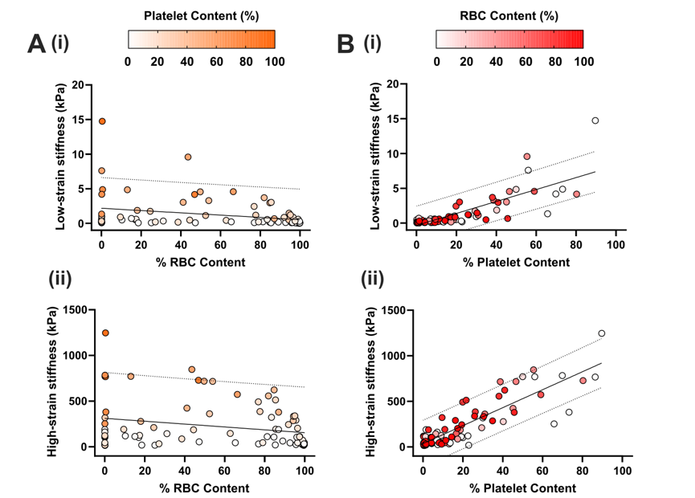
Mechanical properties: platelet and RBC
Cahalane et al. Annals of Biomedical Engineering, (2023)

Slide 44
Mechanical properties: take home message
Patient data:
Variation in mechanical properties is enormous
Correlation with composition seem to be rather intuitive initially
Thrombus analogue data:
Don’t underestimate how much effort it takes to generate protocols to perform reproducible experiments on thrombi
The interplay between RBC and platelets is intricate and the platelets might dominate the mechanical properties

Slide 45
Topics:
How do thrombi from patients look?
Can we regenerate thrombi in-vitro?
How do we measure the mechanical properties?
Can we image the mechanical properties of thrombi?
How can we remove thrombi efficiently?

Slide 46
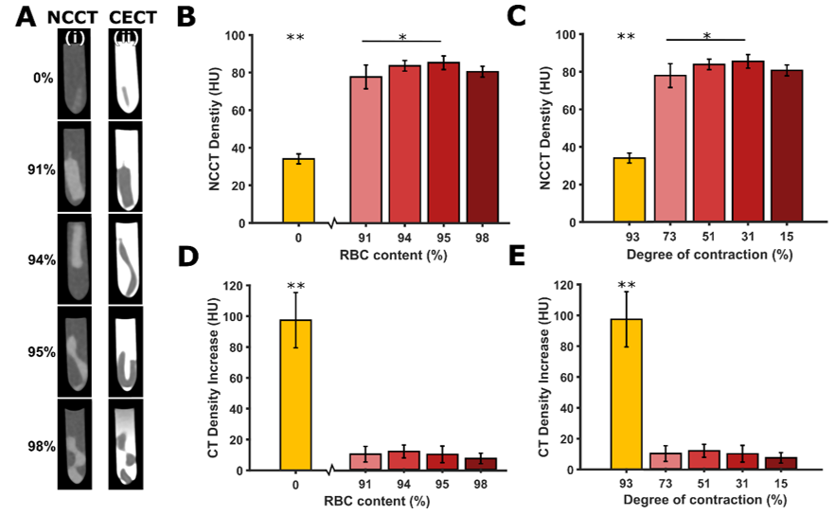
Mechanical properties: can we image them?
Cahalane et al. Annals of Biomedical Engineering, (2023)

Slide 47
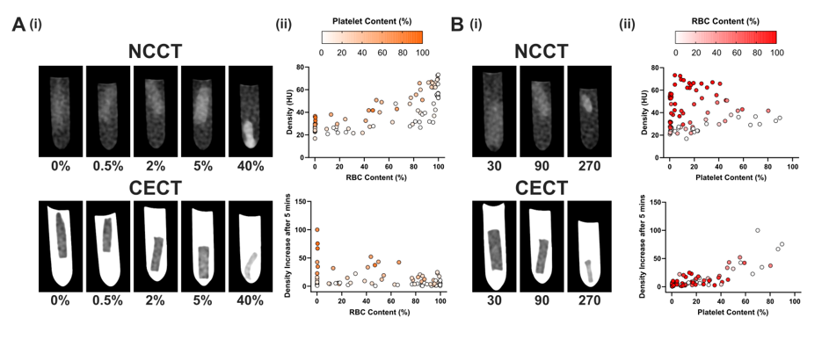
Mechanical properties: imaging
Cahalane et al. in preparation
Notes:
NCCT: Rbc only independently predictive, within a given rbc interval, platelets also positively associated. Platelet concentration alone was not.
CECT: increase in HU after 5 min, measure for permeability, less clear, although, independent of platelet concentration, high cencentrations of RBC seem to be related to lower increase in contrast.

Slide 48
Mechanical properties: imaging
Notes:
NCCT: Rbc only independently predictive, within a given rbc interval, platelets also positively associated. Platelet concentration alone was not.
CECT: increase in HU after 5 min, measure for permeability, less clear, although, independent of platelet concentration, high cencentrations of RBC seem to be related to lower increase in contrast.

Slide 49
Mechanical properties: imaging
Notes:
NCCT: Rbc only independently predictive, within a given rbc interval, platelets also positively associated. Platelet concentration alone was not.
CECT: increase in HU after 5 min, measure for permeability, less clear, although, independent of platelet concentration, high cencentrations of RBC seem to be related to lower increase in contrast.

Slide 50
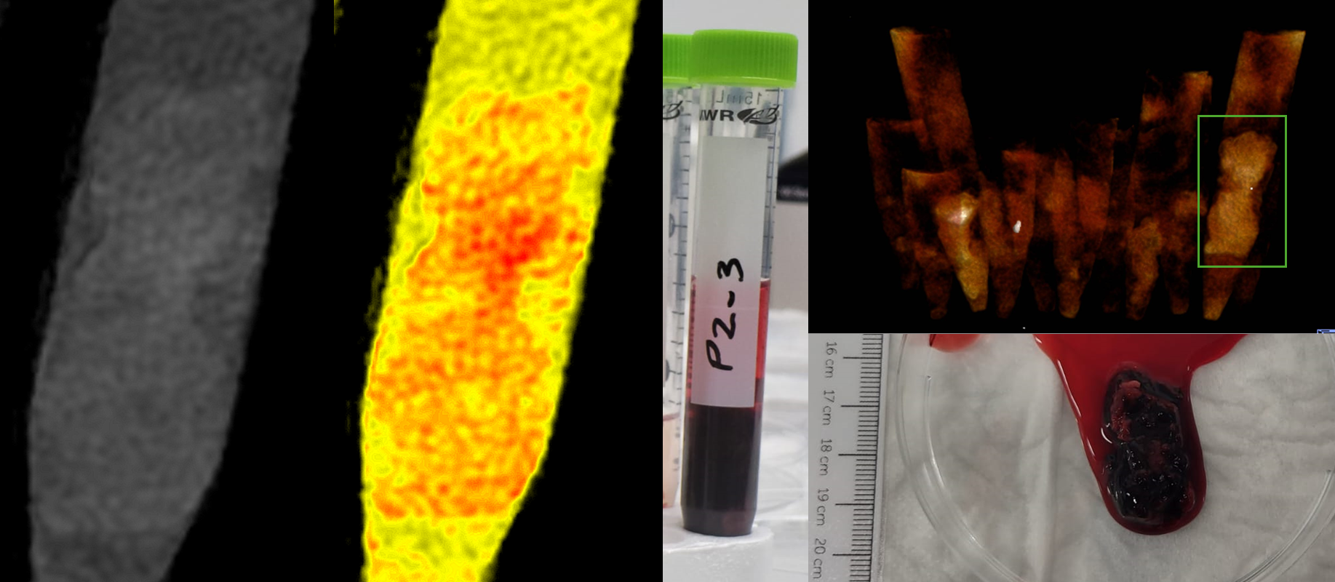
Mechanical properties: PCCT imaging
Notes:
NCCT: Rbc only independently predictive, within a given rbc interval, platelets also positively associated. Platelet concentration alone was not.
CECT: increase in HU after 5 min, measure for permeability, less clear, although, independent of platelet concentration, high cencentrations of RBC seem to be related to lower increase in contrast.

Slide 51
Imaging properties: take home message
Thrombus analogues:
Extremes can be imaged with some reliability
The link between conventional CT data, composition and mechanical properties( (no?)
PCCT will provide more detailed information on composition
We might/will need to establish this link more firmly
Patient data:
These data are collected over the past two years, analyses in progress!

Slide 52
Topics:
How do thrombi from patients look?
Can we regenerate thrombi in-vitro?
How do we measure the mechanical properties?
Can we image the mechanical properties of thrombi?
How can we remove thrombi efficiently?

Slide 53
Mechanical forces acting on a thrombus
Liu et al. JNIS (2020)

Slide 54
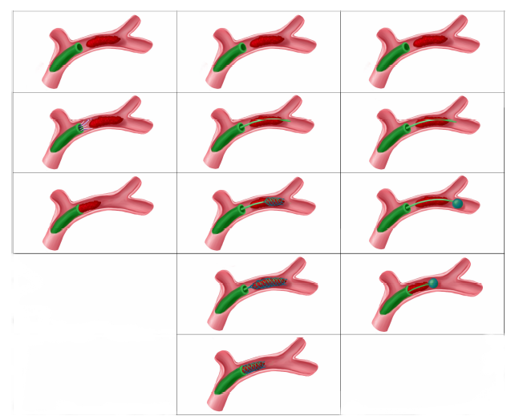
What if we grip the thrombus?
Liu et al. JNIS (2020)

Slide 55
What if we grip the thrombus?
Liu et al. JNIS (2020)

Slide 56
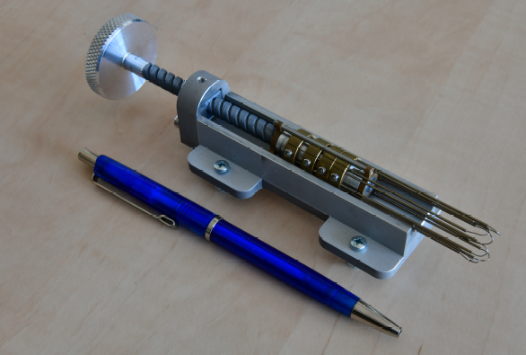
What if we grip the thrombus?
Liu et al. JNIS (2020)

Slide 57
What if we grip the thrombus?
Liu et al. JNIS (2020)

Slide 58
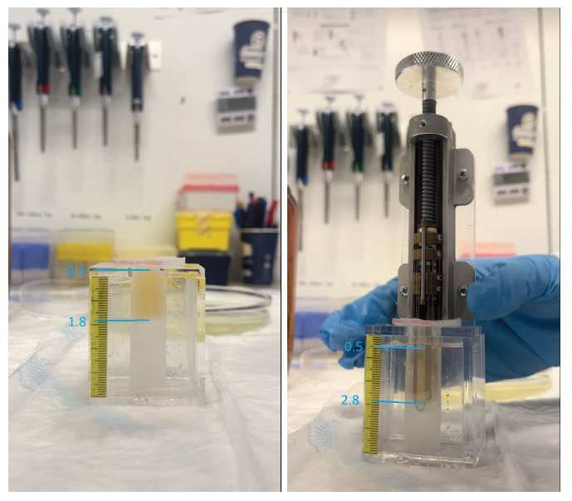
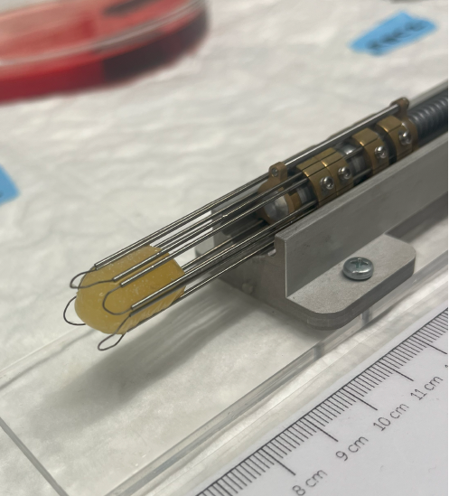
What if we grip the thrombus?
Liu et al. JNIS (2020)

Slide 59
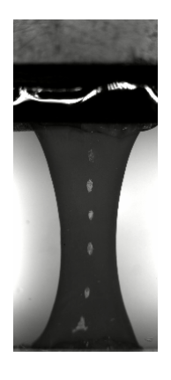
Acknowledgements
TUDelft, Cardiovascular Biomechanics Lab:
Ali Akyildiz
Mathias Peirlinck
Behrooz Fereidoonnezhad
Selene Pirola
TUDelft, Bioinspired design
Paul Breeveld Sasha Zurawska
Erasmus Medical Center, Biomechanics lab:
Rachel Cahalane
Jo-Anne Giezen
Stephanie Naudin
Kim van Gaalen
Otilia Ilie
Tracy Zhang
Erasmus Medical Center, clinical partners
Diederik Dippel
Aad van der Lugt
Nikki Boodt
Adriaan Moelker
Noor Samuels

Slide 60
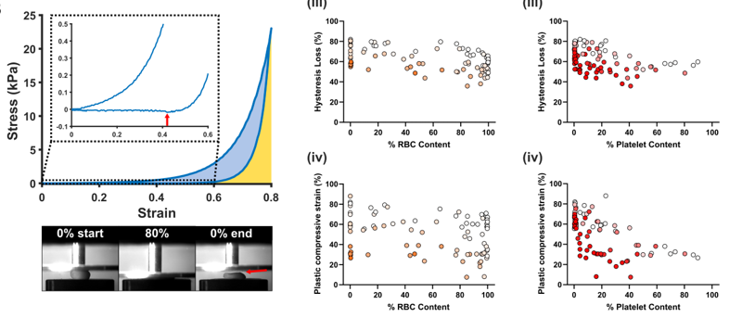
Mechanical properties: platelet and RBC

Slide 61
Mechanical properties: can we model them?
Fereidoonnezhad, McGarry, J Biomech., 2022.
Notes:
Panel A: original fibrin network with bonds, B, bonds get dissociated under stretch, new bonds get formed, and panel D shows macro behavior of structure. To be cast in continuum mech approach, works well

Slide 62
Mechanical properties: can we model them?
Cardona, Peirlicnk, and Fereidoonnezhad, unpublished data

Slide 63
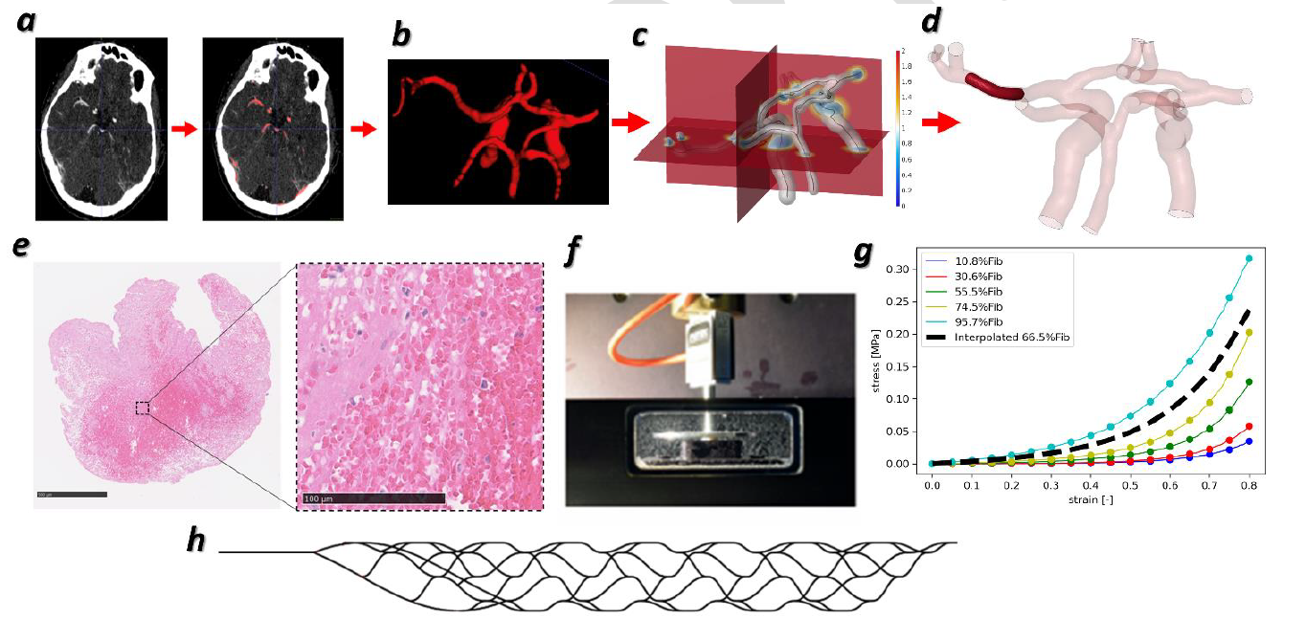
Mechanical properties: can we use them?
Luraghi et al, J Biomech., 2021.

Slide 64
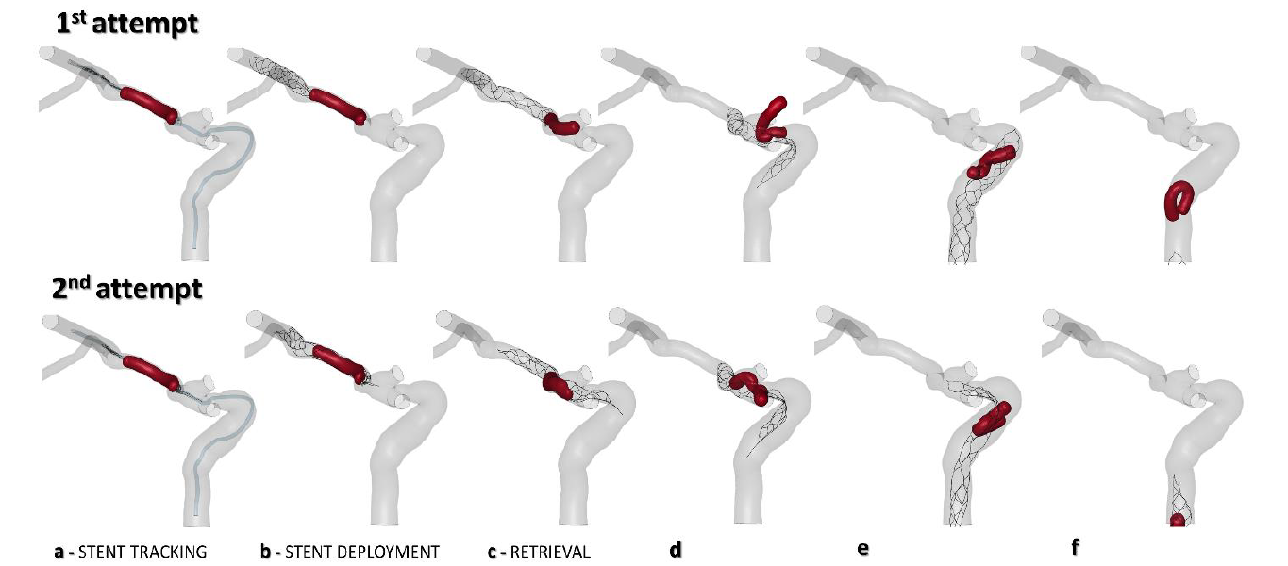
Mechanical properties: can we use them?
Luraghi et al, J Biomech., 2021.

Slide 65
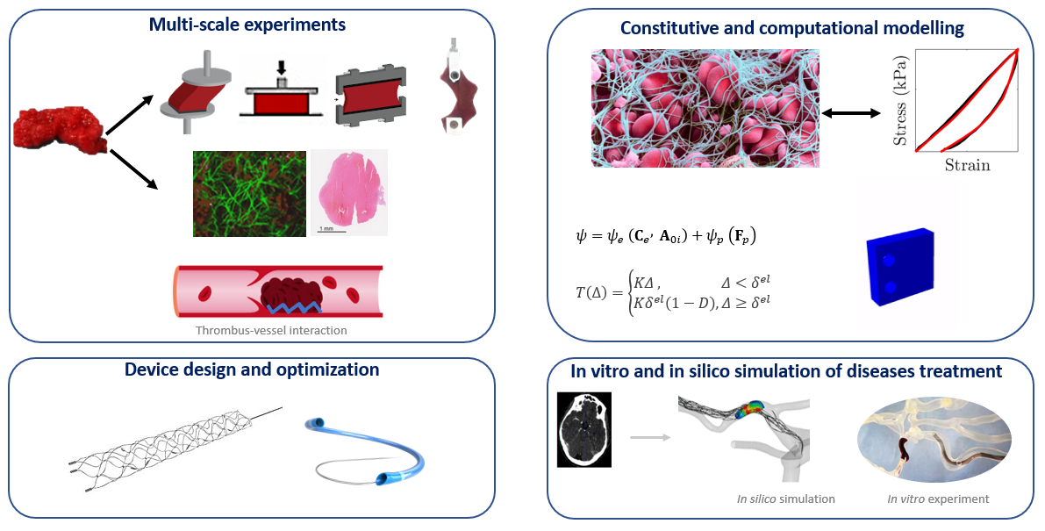
Mechanical properties: can we use them?
Luraghi et al, J Biomech., 2021.

Slide 66
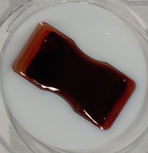
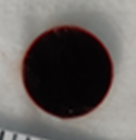
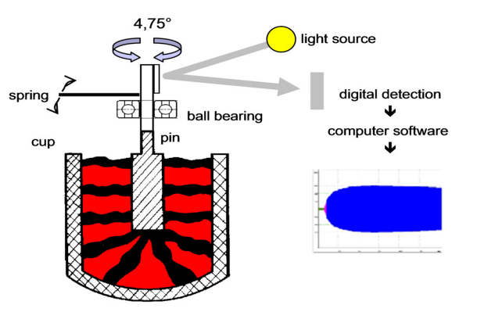
Mechanical properties: can we use them?
The aSsociation between PatiEnt-speCific In vitro clot Mechanics and Endovascular treatmeNt reperfusion (SPECIMENS)
SPECIMENS Protocol
Sample Preparation
Mechanical Tests
Clinical Parameters
Tension
Compression
Fracture
Rotational-thrombo-elastometry
Reperfusion grade (eTICI)
Embolization
Number of passes
Length of procedure
1 x sodium citrate tube
Whole blood clot analogues

Slide 67
Mechanical properties: can we use them?
SPECIMENS
MRCLOT
Can whole blood clot analogue mechanics predict EVT reperfusion?
Can pre-interventional CT characteristics predict thrombus mechanics and EVT reperfusion?
n = 60
Compare ex vivo thrombus and blood clot analogue from same patient
n = 66

Slide 68
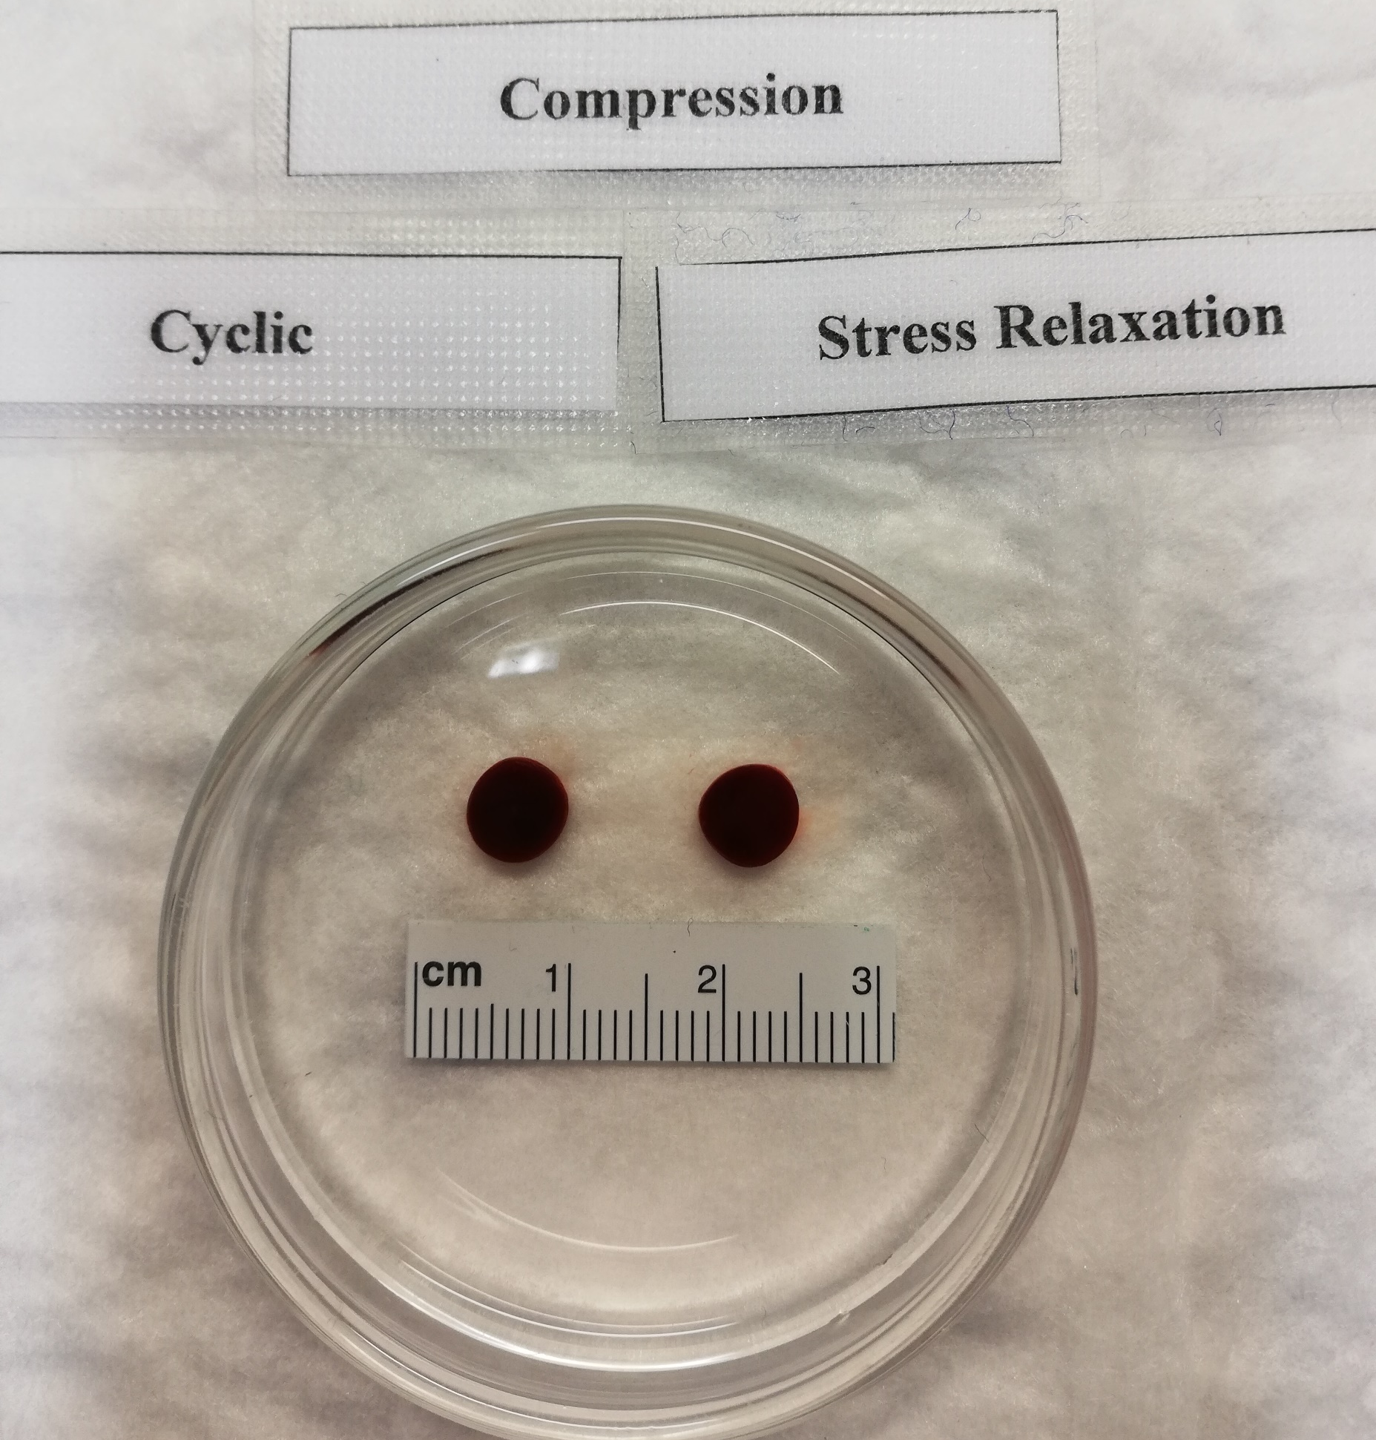
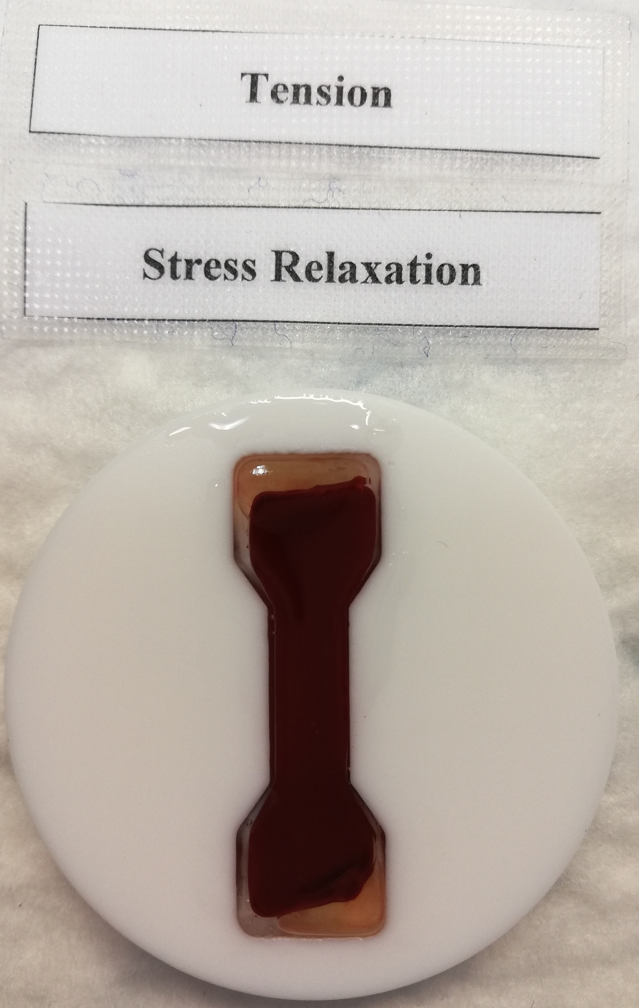
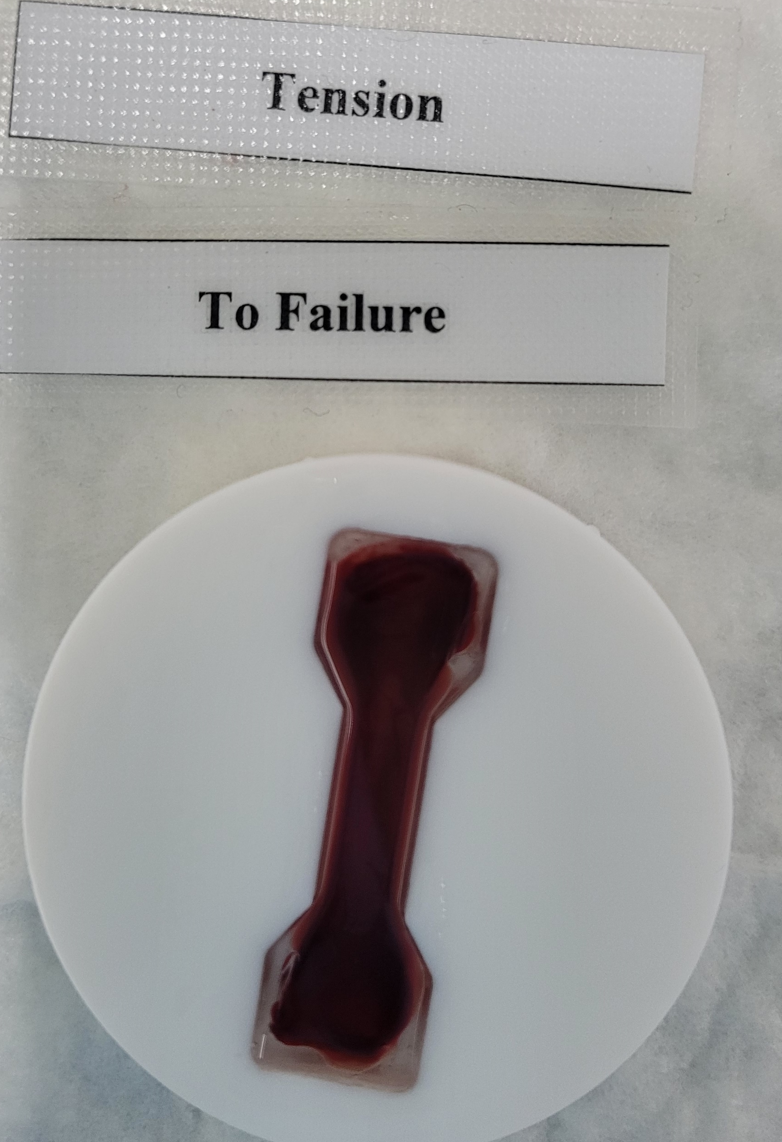
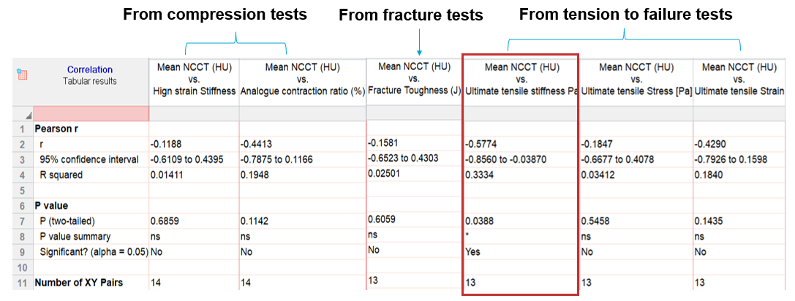
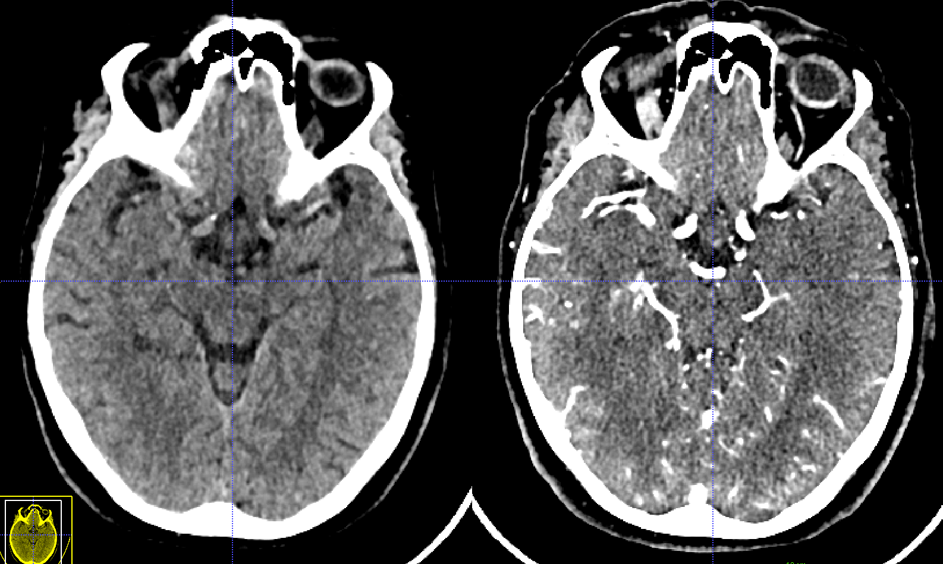
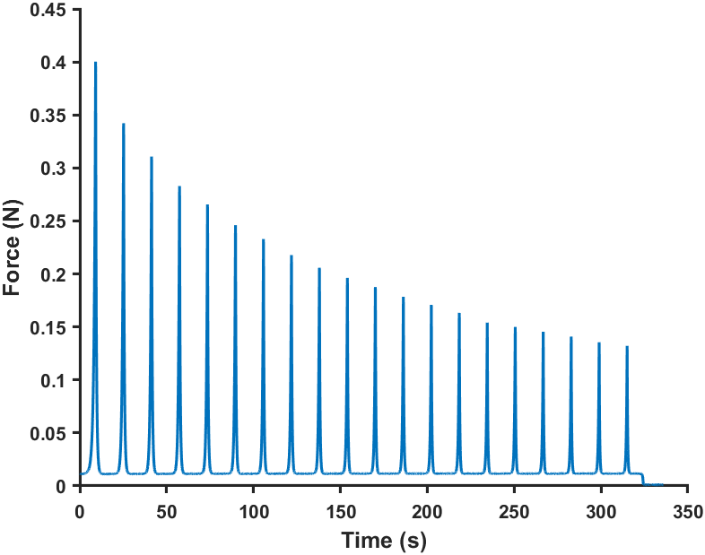
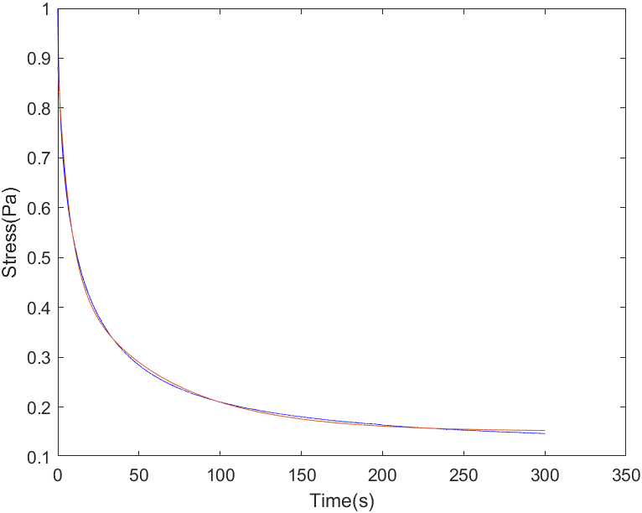
Mechanical properties: can we use them?
Stress (Pa)
Strain

Slide 69
Discussion and conclusion
Can we regenerate thrombi in-vitro:
Yes we can, but statically generated thrombi are homogeneous!
The interplay between fibrin, RBC and platelets is delicate
Can we measure the mechanical properties:
Yes we can, but care should be taken when preparing the samples
The interplay between fibrin, RBC and platelets is delicate
Can we image the mechanical properties of thrombi:
Only to a certain degree, physics are poorly understood
The interplay between fibrin, RBC and platelets is delicate
Can we model the mechanical properties of thrombi:
Macroscopic models are useful, microscale models might be necessary.
The interplay between fibrin, RBC and platelets is delicate
Can we use the mechanical properties in (clinical) practice:
To be determined
But the interplay between fibrin, RBC and platelets is delicate
The interplay

