Slide 1
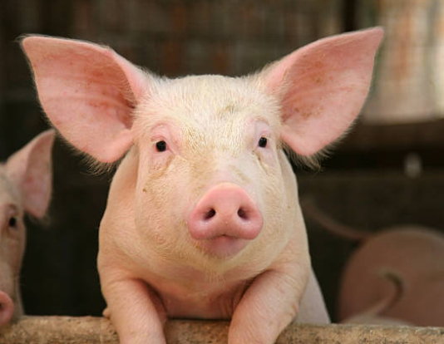
Thromboinflammation- what is it?

Slide 2
Thromboinflammation- what is the correct definition?
Thromboinflammation is a pathological condition characterized by the concurrence of thrombosis, inflammation, and vascular leakage/bleeding, which induce and exacerbate each other leading to tissue/organ injury and death. Thromboinflammation may occur in a wide range of inflammatory and cardiovascular/pulmonary diseases, including severe infection (eg, sepsis and severe COVID-19), acute respiratory distress syndrome (ARDS), ischemia-reperfusion injury following myocardial infarction, organ transplant and acute kidney ischemia, cardiac arrest, severe injury, autoimmune diseases, thrombosis (eg, deep vein thrombosis), and atherosclerosis.^{1,2} Thromboinflammation can be acute and chronic and can be severe with high mortality and morbidity. Despite many years of intensive efforts and development of anti-inflammatory and antithrombotic drugs, there is still no current drug available that is convincingly effective in the treatment of thromboinflammation. The reason for the ineffectiveness of many anti-inflammatory and antithrombotic drugs is unclear. However, past and recent studies and clinical trials shed mechanistic light and raise hopes for new therapeutic concepts and drugs.
Mack A et al
Inflammation and thrombosis are intricate and closely interconnected biological processes that are not yet fully understood and lack effective targeted therapeutic approaches. Thrombosis initiated by inflammatory responses, known as immunothrombosis, can confer advantages to the host by constraining the spread of pathogens within the bloodstream. Conversely, platelets and the coagulation cascade can influence inflammatory responses through interactions with immune cells, endothelium, or complement system. These interactions can lead to a state of heightened inflammation resulting from thrombotic processes, termed as thromboinflammation.
Schrottmaier WC, Assinger A. The concept of thromboinflammation. Haemostaseologie 2024; 44: 21-30

Slide 3
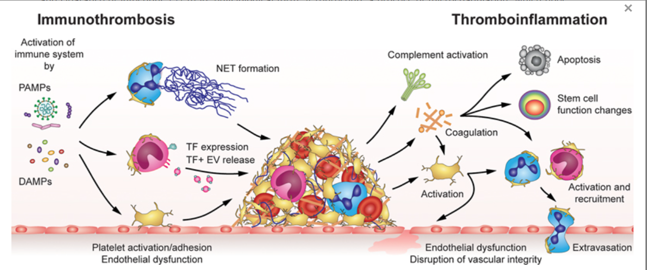
For me thromboinflammation covers both of these events

Slide 4
“Immunothrombosis” definitions
Consequences of inflammation
“The end point of inflammation is thrombosis”
Antibody-mediated thrombosis includes
Antiphospholipid syndrome
Acquired thrombotic thrombocytopenic purpura
Heparin- induced thrombocytopenia & thrombosis
Vaccine-induced thrombocytopenia and thrombosis
Thrombotic monoclonal gammopathy
Antibody-mediated rejection

Slide 5
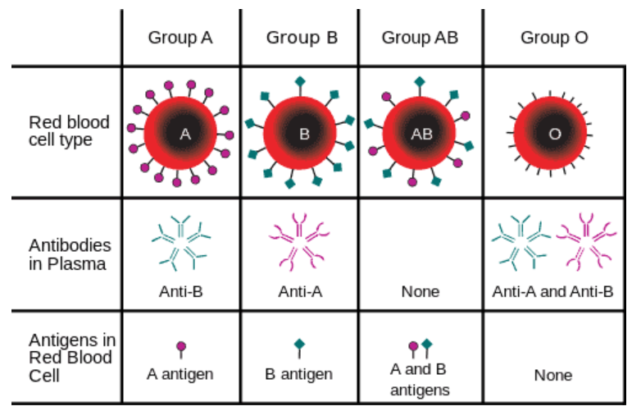
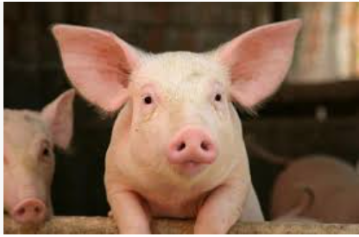
Where it started from for me…

Slide 6
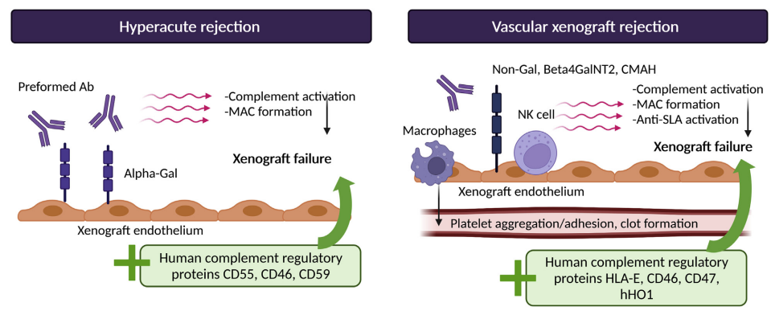
Where I started from- hyperacute rejection

Slide 7
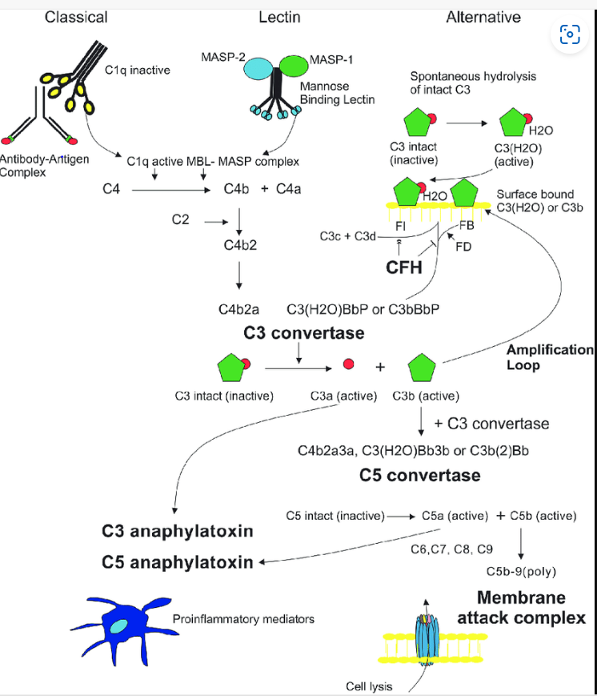
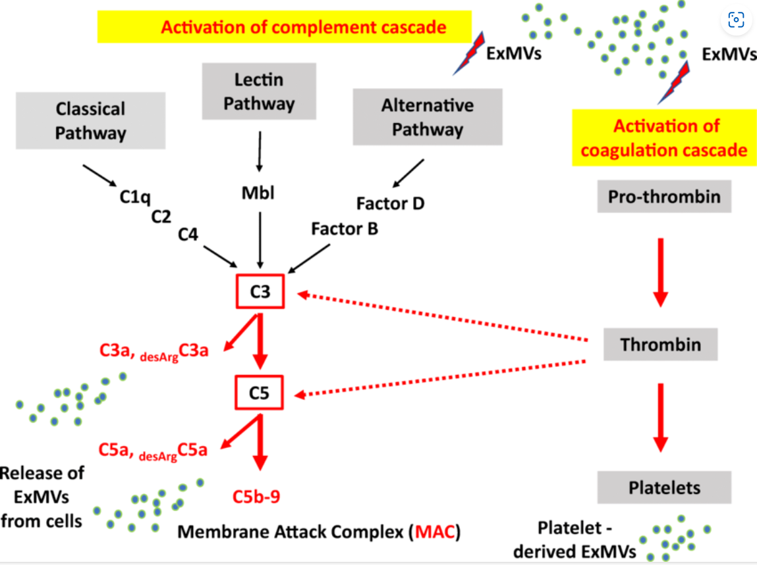
Complement Complement & coagulation cross talk

Slide 8
Immunology and haemostasis are entwined
Activation of haemostasis
Activation of immune response

Slide 9
Immunology and haemostasis are entwined
Activation of haemostasis
Activation of immune response
They work together

Slide 10
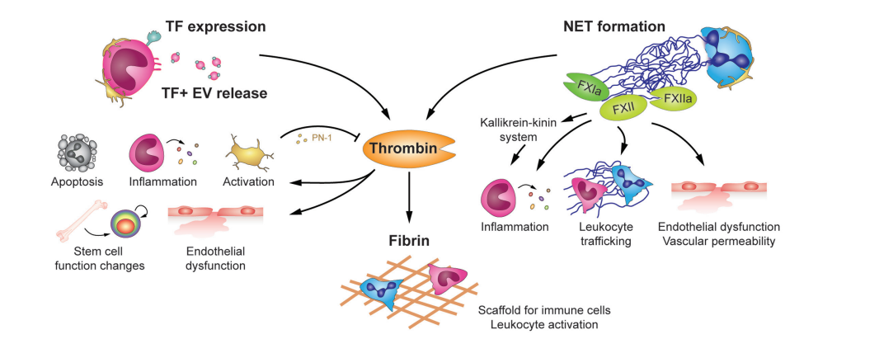
The effect of coagulation on immune response

Slide 11
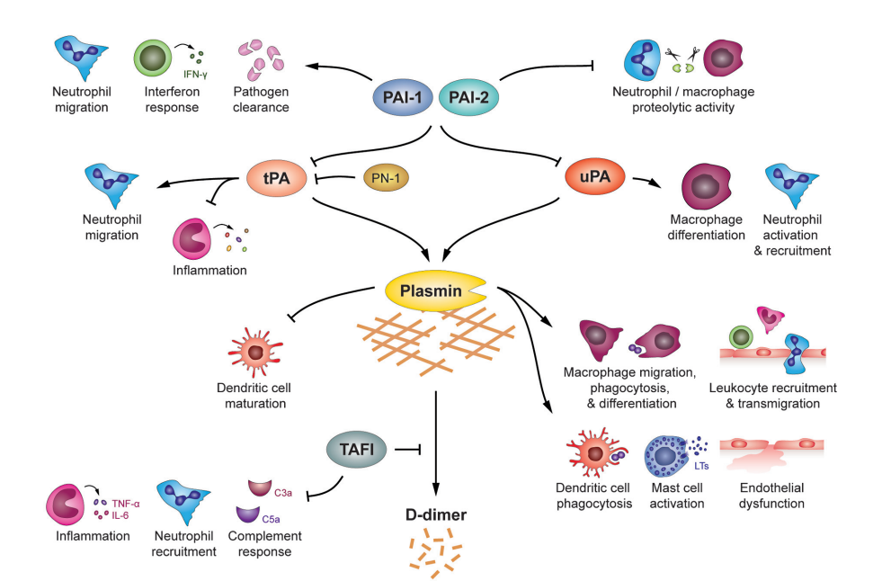
Immunomodulatory roles of fibrinolysis

Slide 12
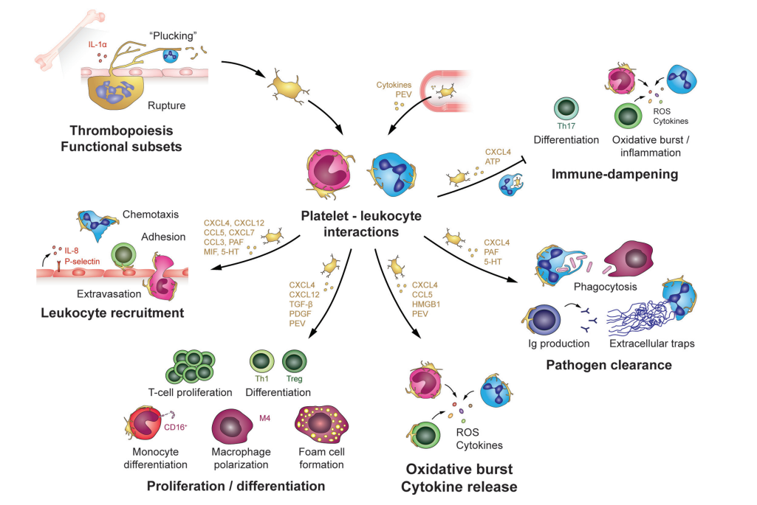
The role of platelets in thromboinflammation

Slide 13
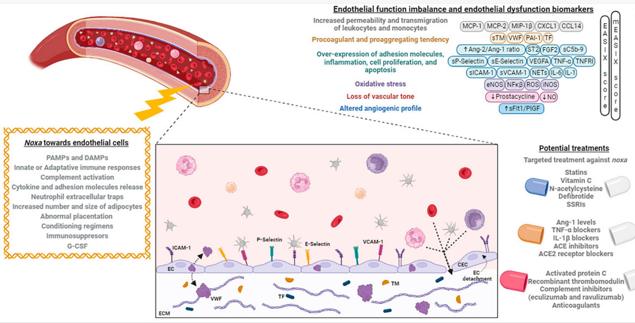

Slide 14
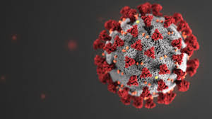
Clots and Covid-19: lessons learnt
Prof Beverley J Hunt OBE
Twitter: @bhwords
Strategic lead in Haematology, Synnlab
Prof of Thombosis & Haemostasis
Kings Healthcare Partners
Founder & Trustee of Thrombosis UK

Slide 15
Clots and Covid-19: lessons learnt
Prof Beverley J Hunt OBE
Twitter: @bhwords
Strategic lead in Haematology, Synnlab
Prof of Thombosis & Haemostasis
Kings Healthcare Partners
Founder & trustee of Thrombosis UK
Conflicts of interest
C0-Chair of World Health Organisation COVID-19 GDG

Slide 16
Aiming to cover:
Where are we now with our understanding of :
Acute COVID-19 pneumonia & thrombosis
Vaccine-induced thrombocytopenia and thrombosis

Slide 17
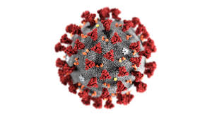
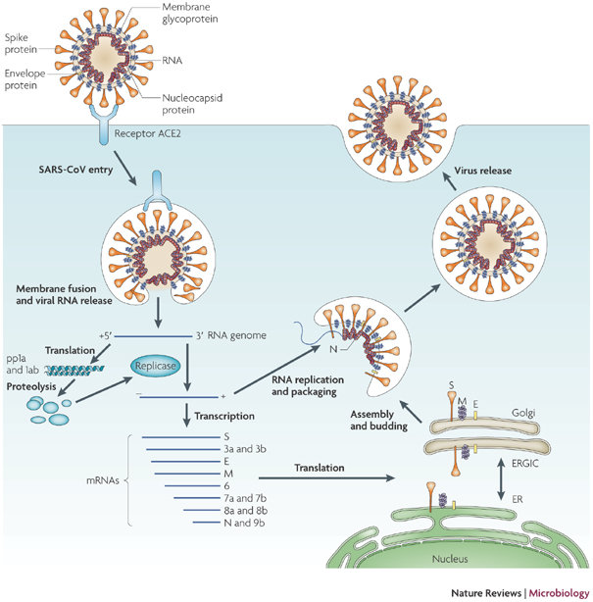

COVID-19 pathogenesis
ACE2 receptor on
Pulmonary epithelium
& endothelium

Slide 18

COVID-19 pathogenesis
Asymptomatic
Minor infection
7-10 days fever &/or flu-like symptoms
anosmia
ACE2 receptor on
Pulmonary epithelium
& endothelium

Slide 19
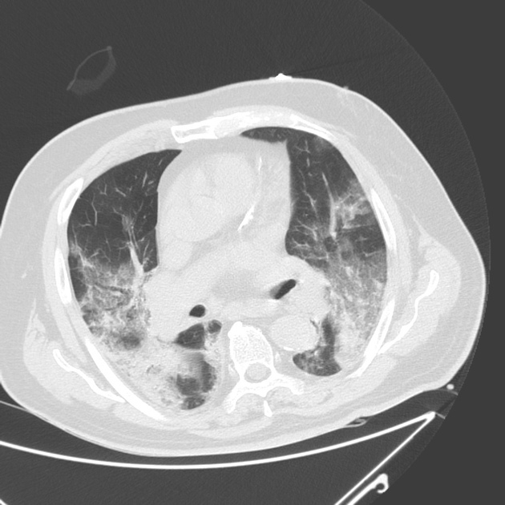

COVID-19 pathogenesis
Asymptomatic
Minor infection
7-10 days fever &/or flu-like symptoms
anosmia
ACE2 receptor on
Pulmonary epithelium
& endothelium
In a minority (5%)
COVID-19 pneumonia
Massive inflammatory response
Cytokine storm/macrophage activation

Slide 20

COVID-19 pathogenesis
Asymptomatic
Minor infection
7-10 days fever &/or flu-like symptoms
anosmia
ACE2 receptor on
Pulmonary epithelium
& endothelium
Moderate
(may need O2)
In a minority (5%)
COVID-19 pneumonia
Massive inflammatory response
Cytokine storm/macrophage activation
Severe/critical
(needs mechanical
Ventilation)

Slide 21

COVID-19 pathogenesis
Asymptomatic
Minor infection
7-10 days fever &/or flu-like symptoms
anosmia
ACE2 receptor on
Pulmonary epithelium
& endothelium
In a minority (5%)
COVID-19 pneumonia
Massive inflammatory response
Cytokine storm/macrophage activation
Moderate
(needs O2)
Severe
(needs mechanical
Ventilation)
A pre-existing inflammatory state
makes COVID-19 pneumonia more likely
e.g age, atherosclerosis, diabetes, obesity
Prothrombotic state due to effects of IL1, IL-6

Slide 22
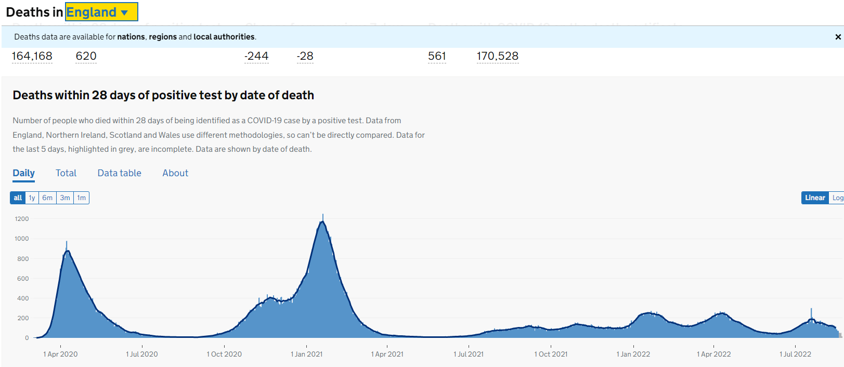
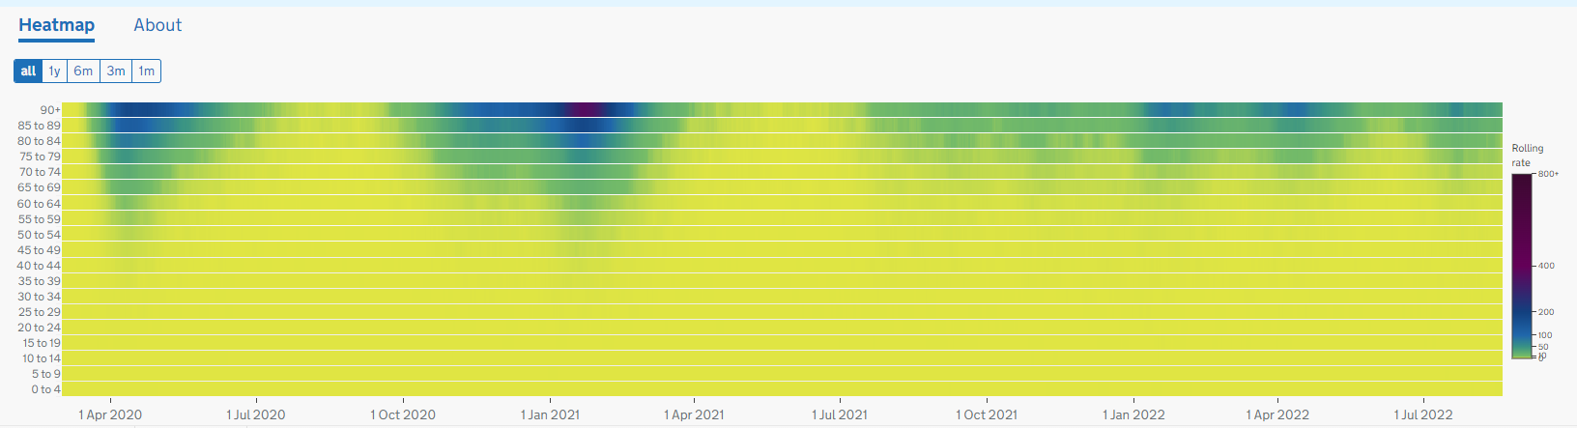

Slide 23
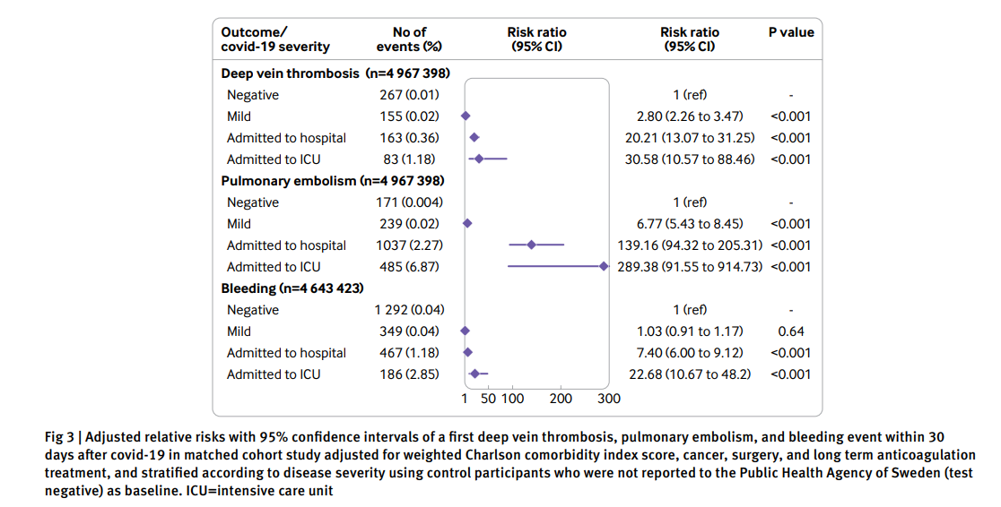
VTE risk Feb 2020- March 2021 in COVID-19 patients BMJ 2022;376:e069590 | doi: 10.1136/bmj-2021-069590

Slide 24
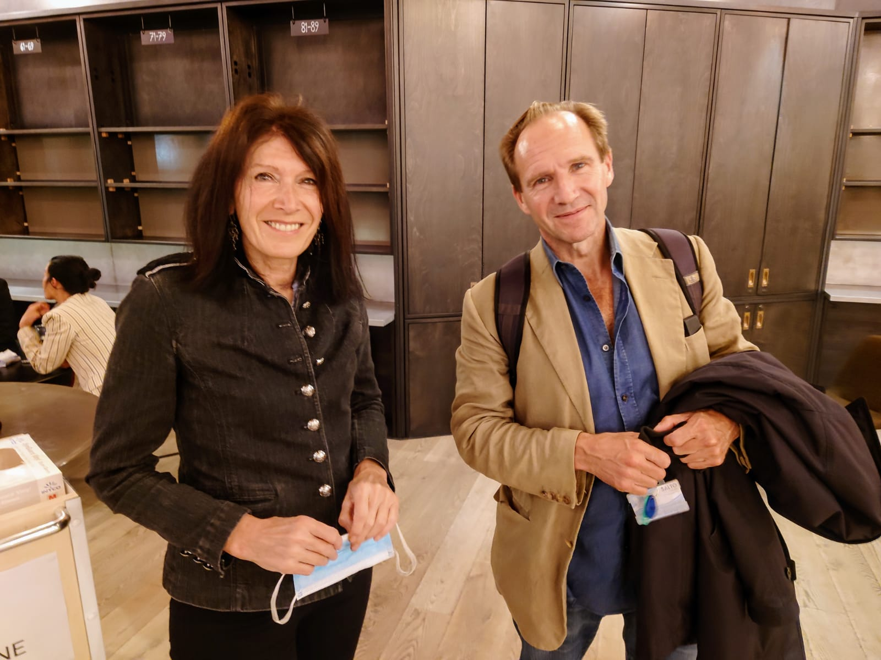

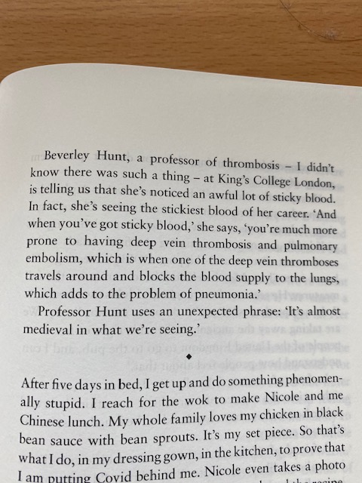
COVID-19 pneumonia causes
-a profound prothrombotic state
High rates of clots

Slide 25
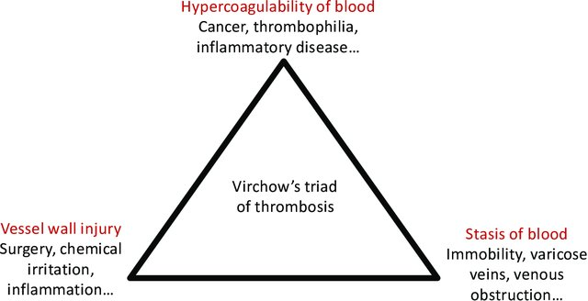
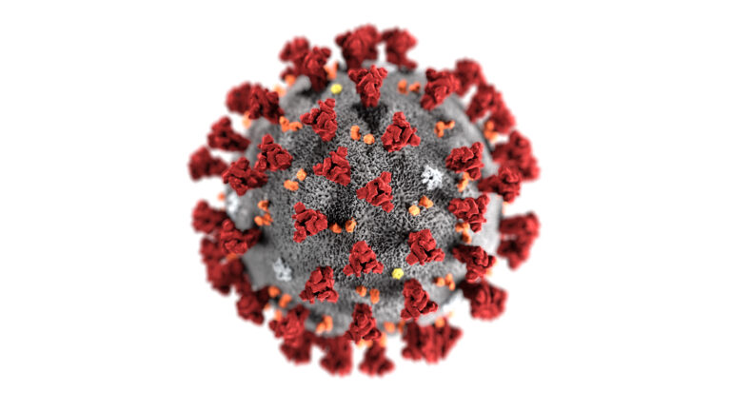
Lung thromboembolism in COVID-19: two pathologies
Immunothrombosis
as described in ARDS from 2013
COVID-19 pneumonia
Local inflammation in pulmonary vasculature
Deep vein thrombosis
Embolisation
Pulmonary embolism
Pulmonary thrombosis

Slide 26
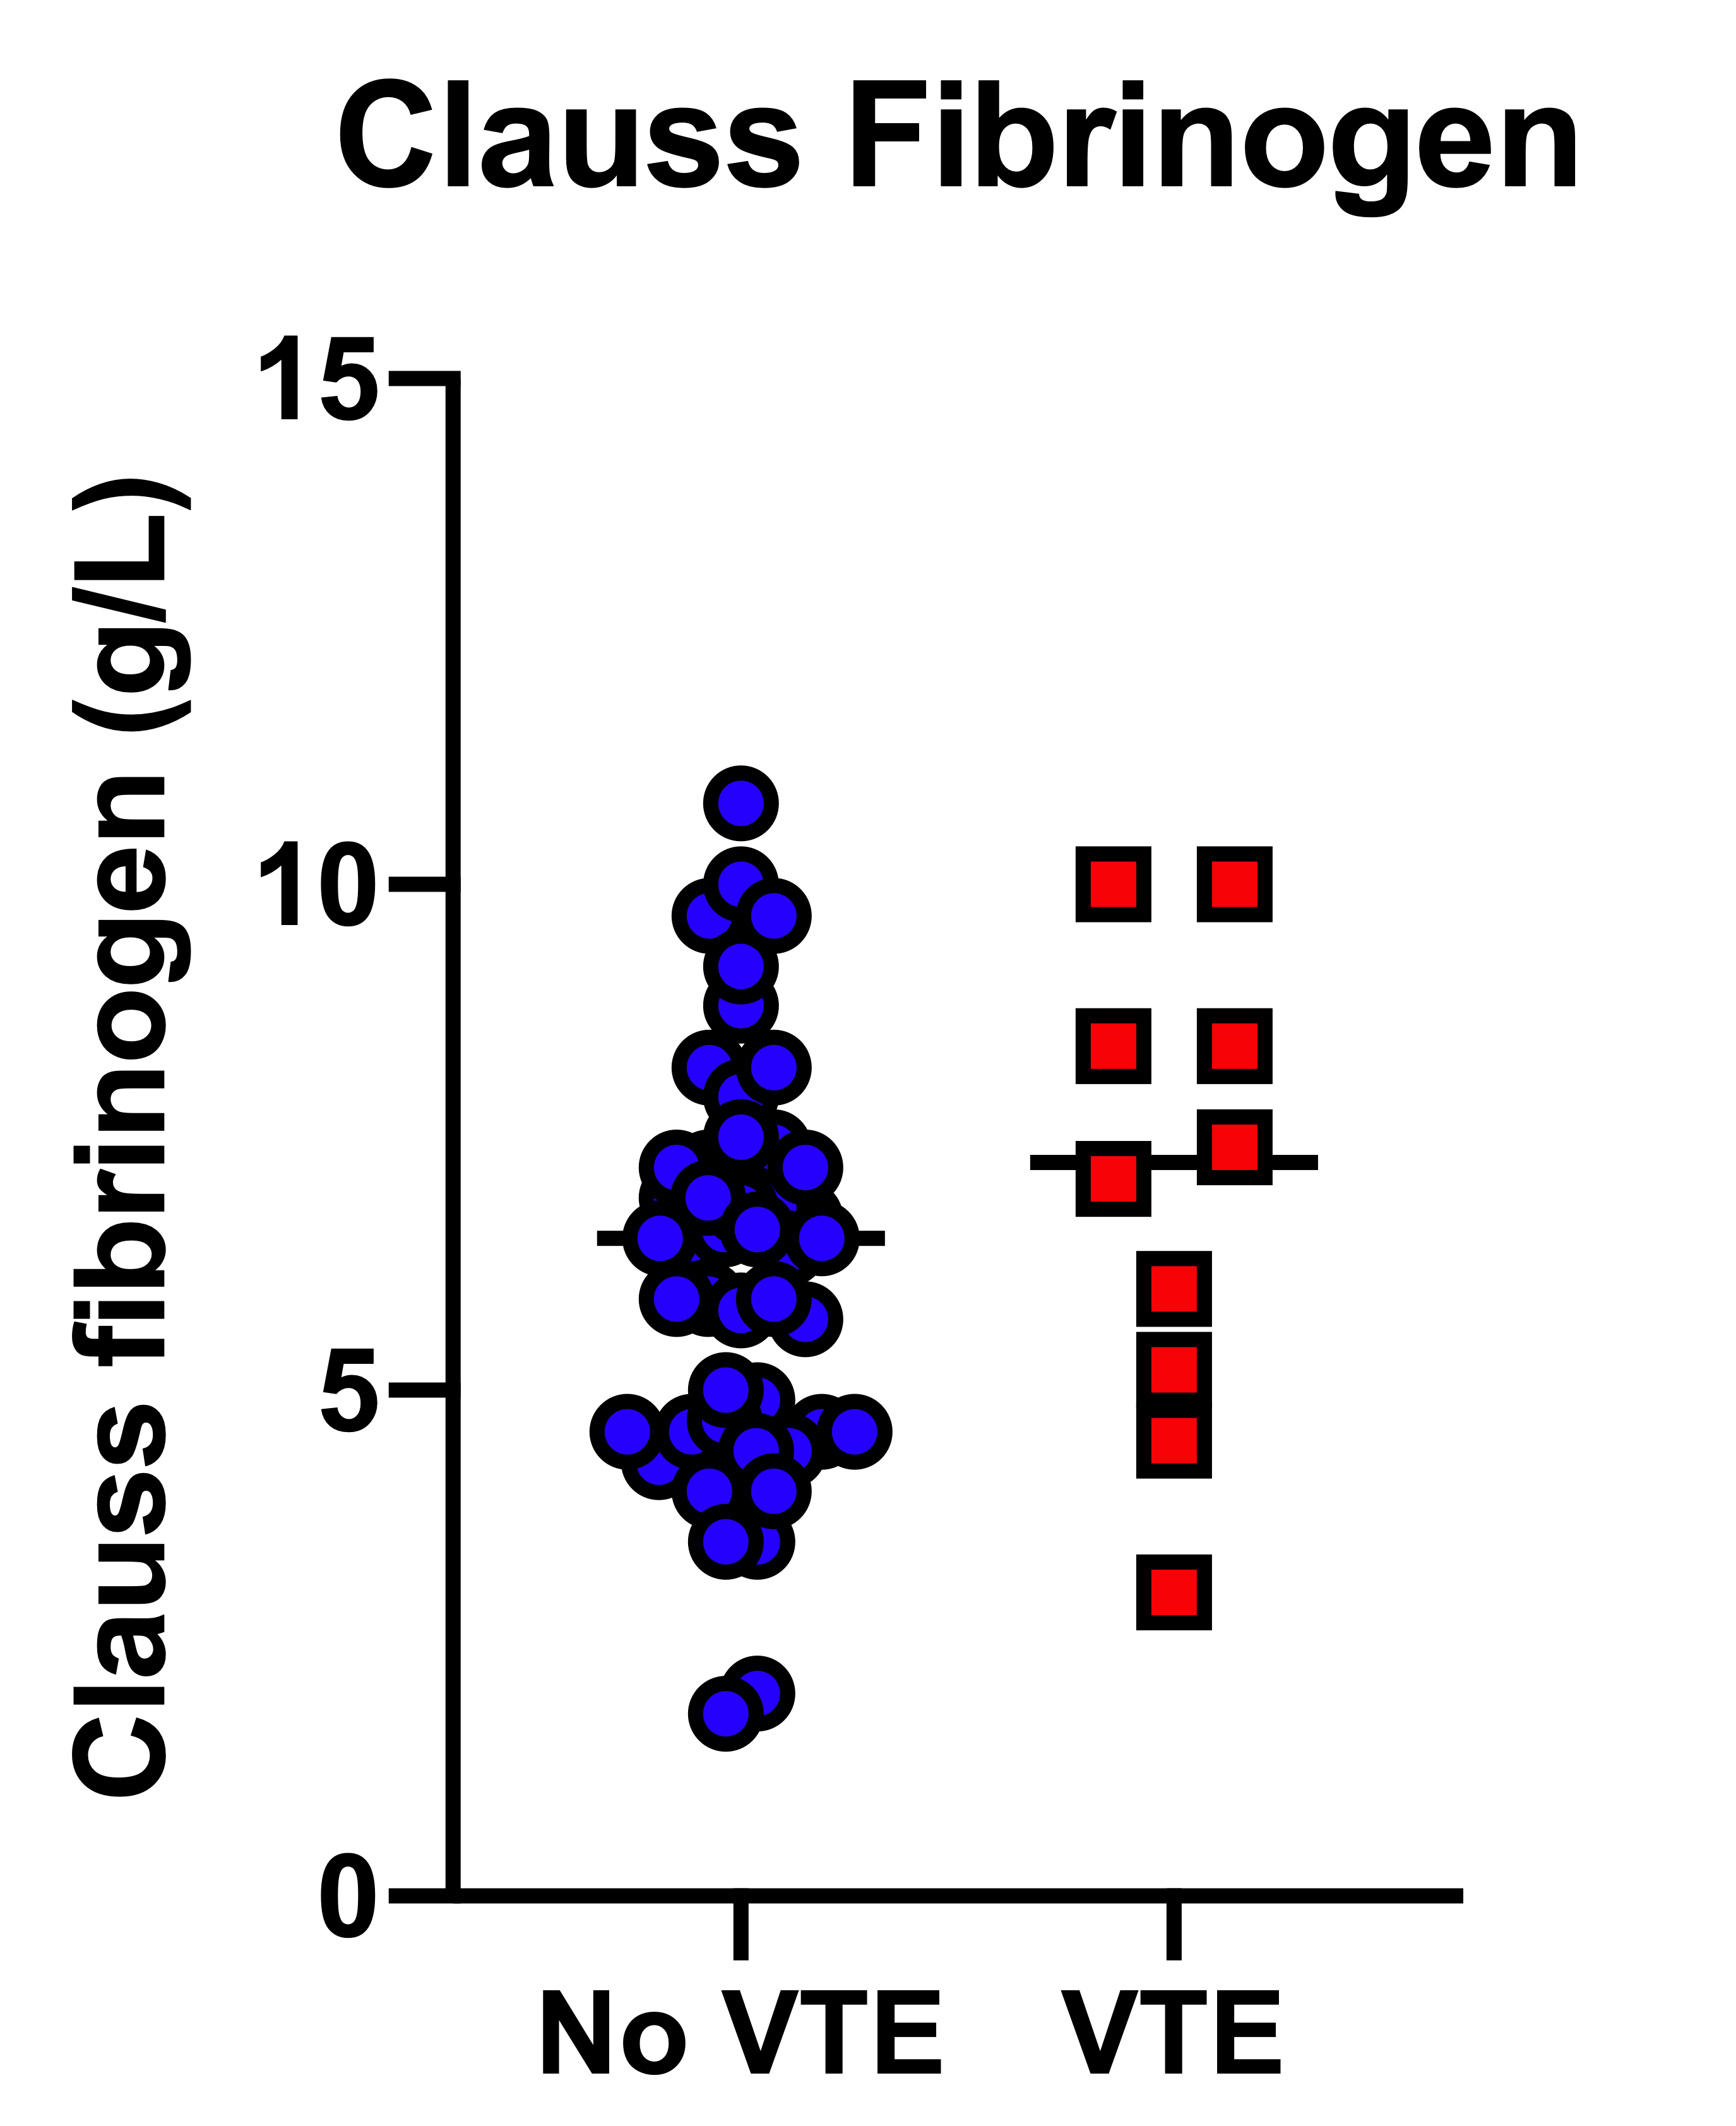
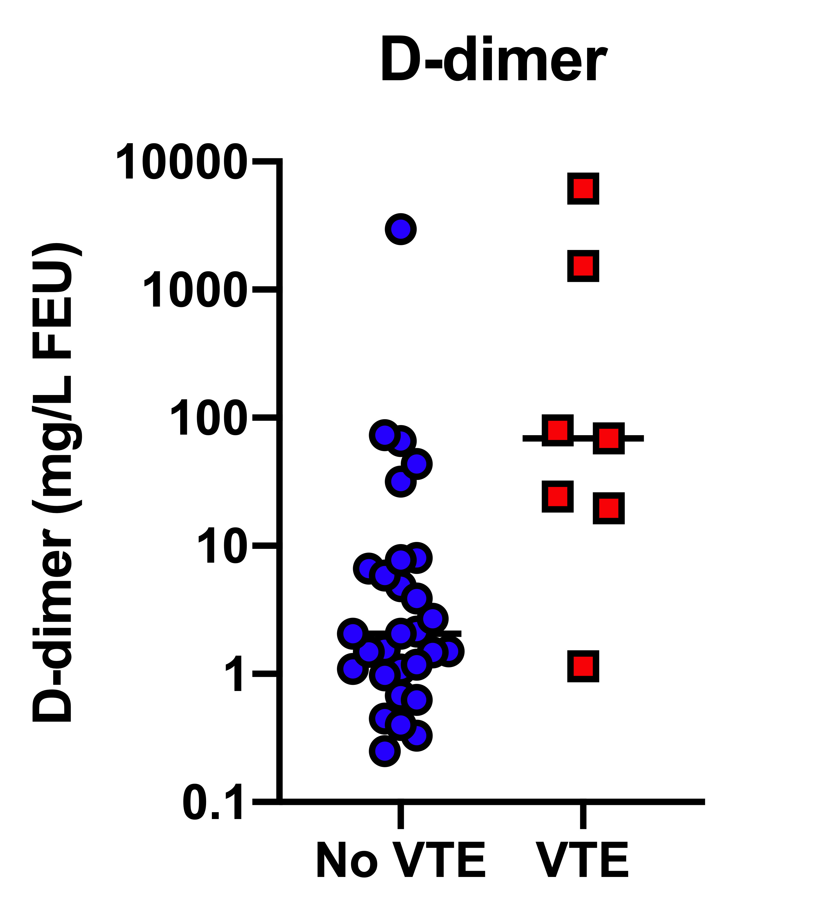
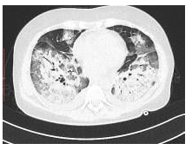
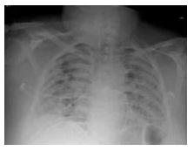
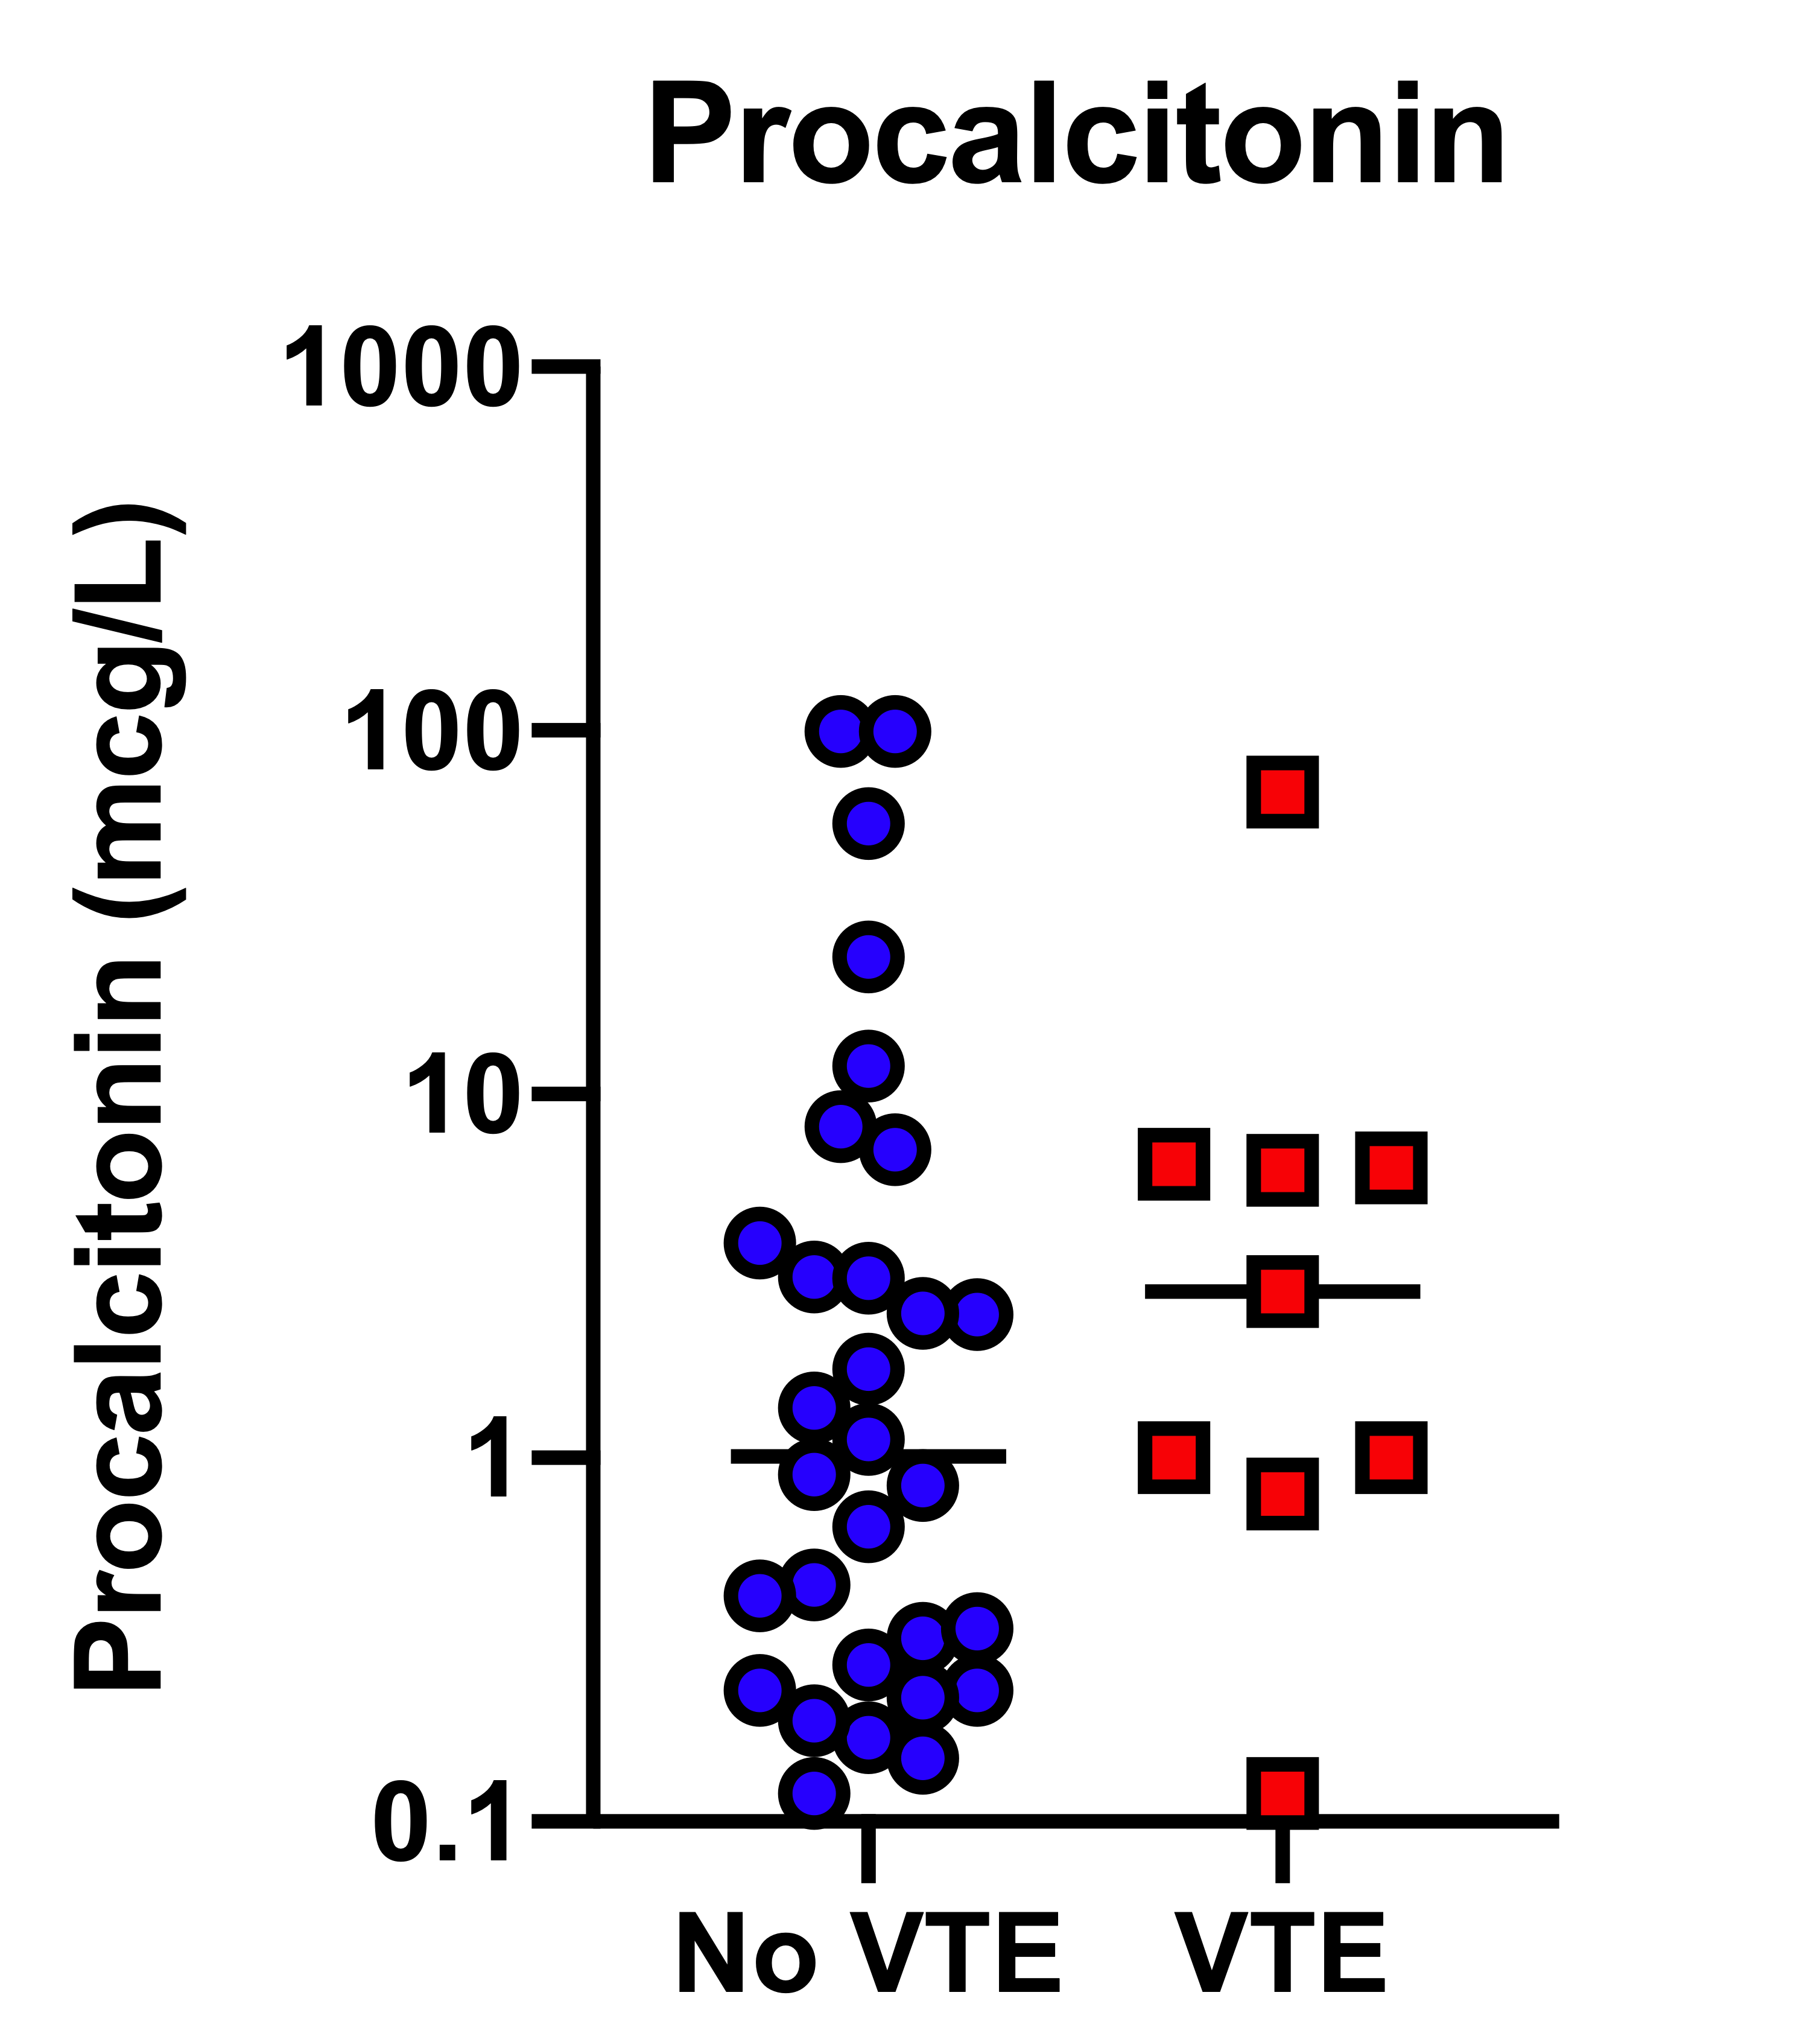
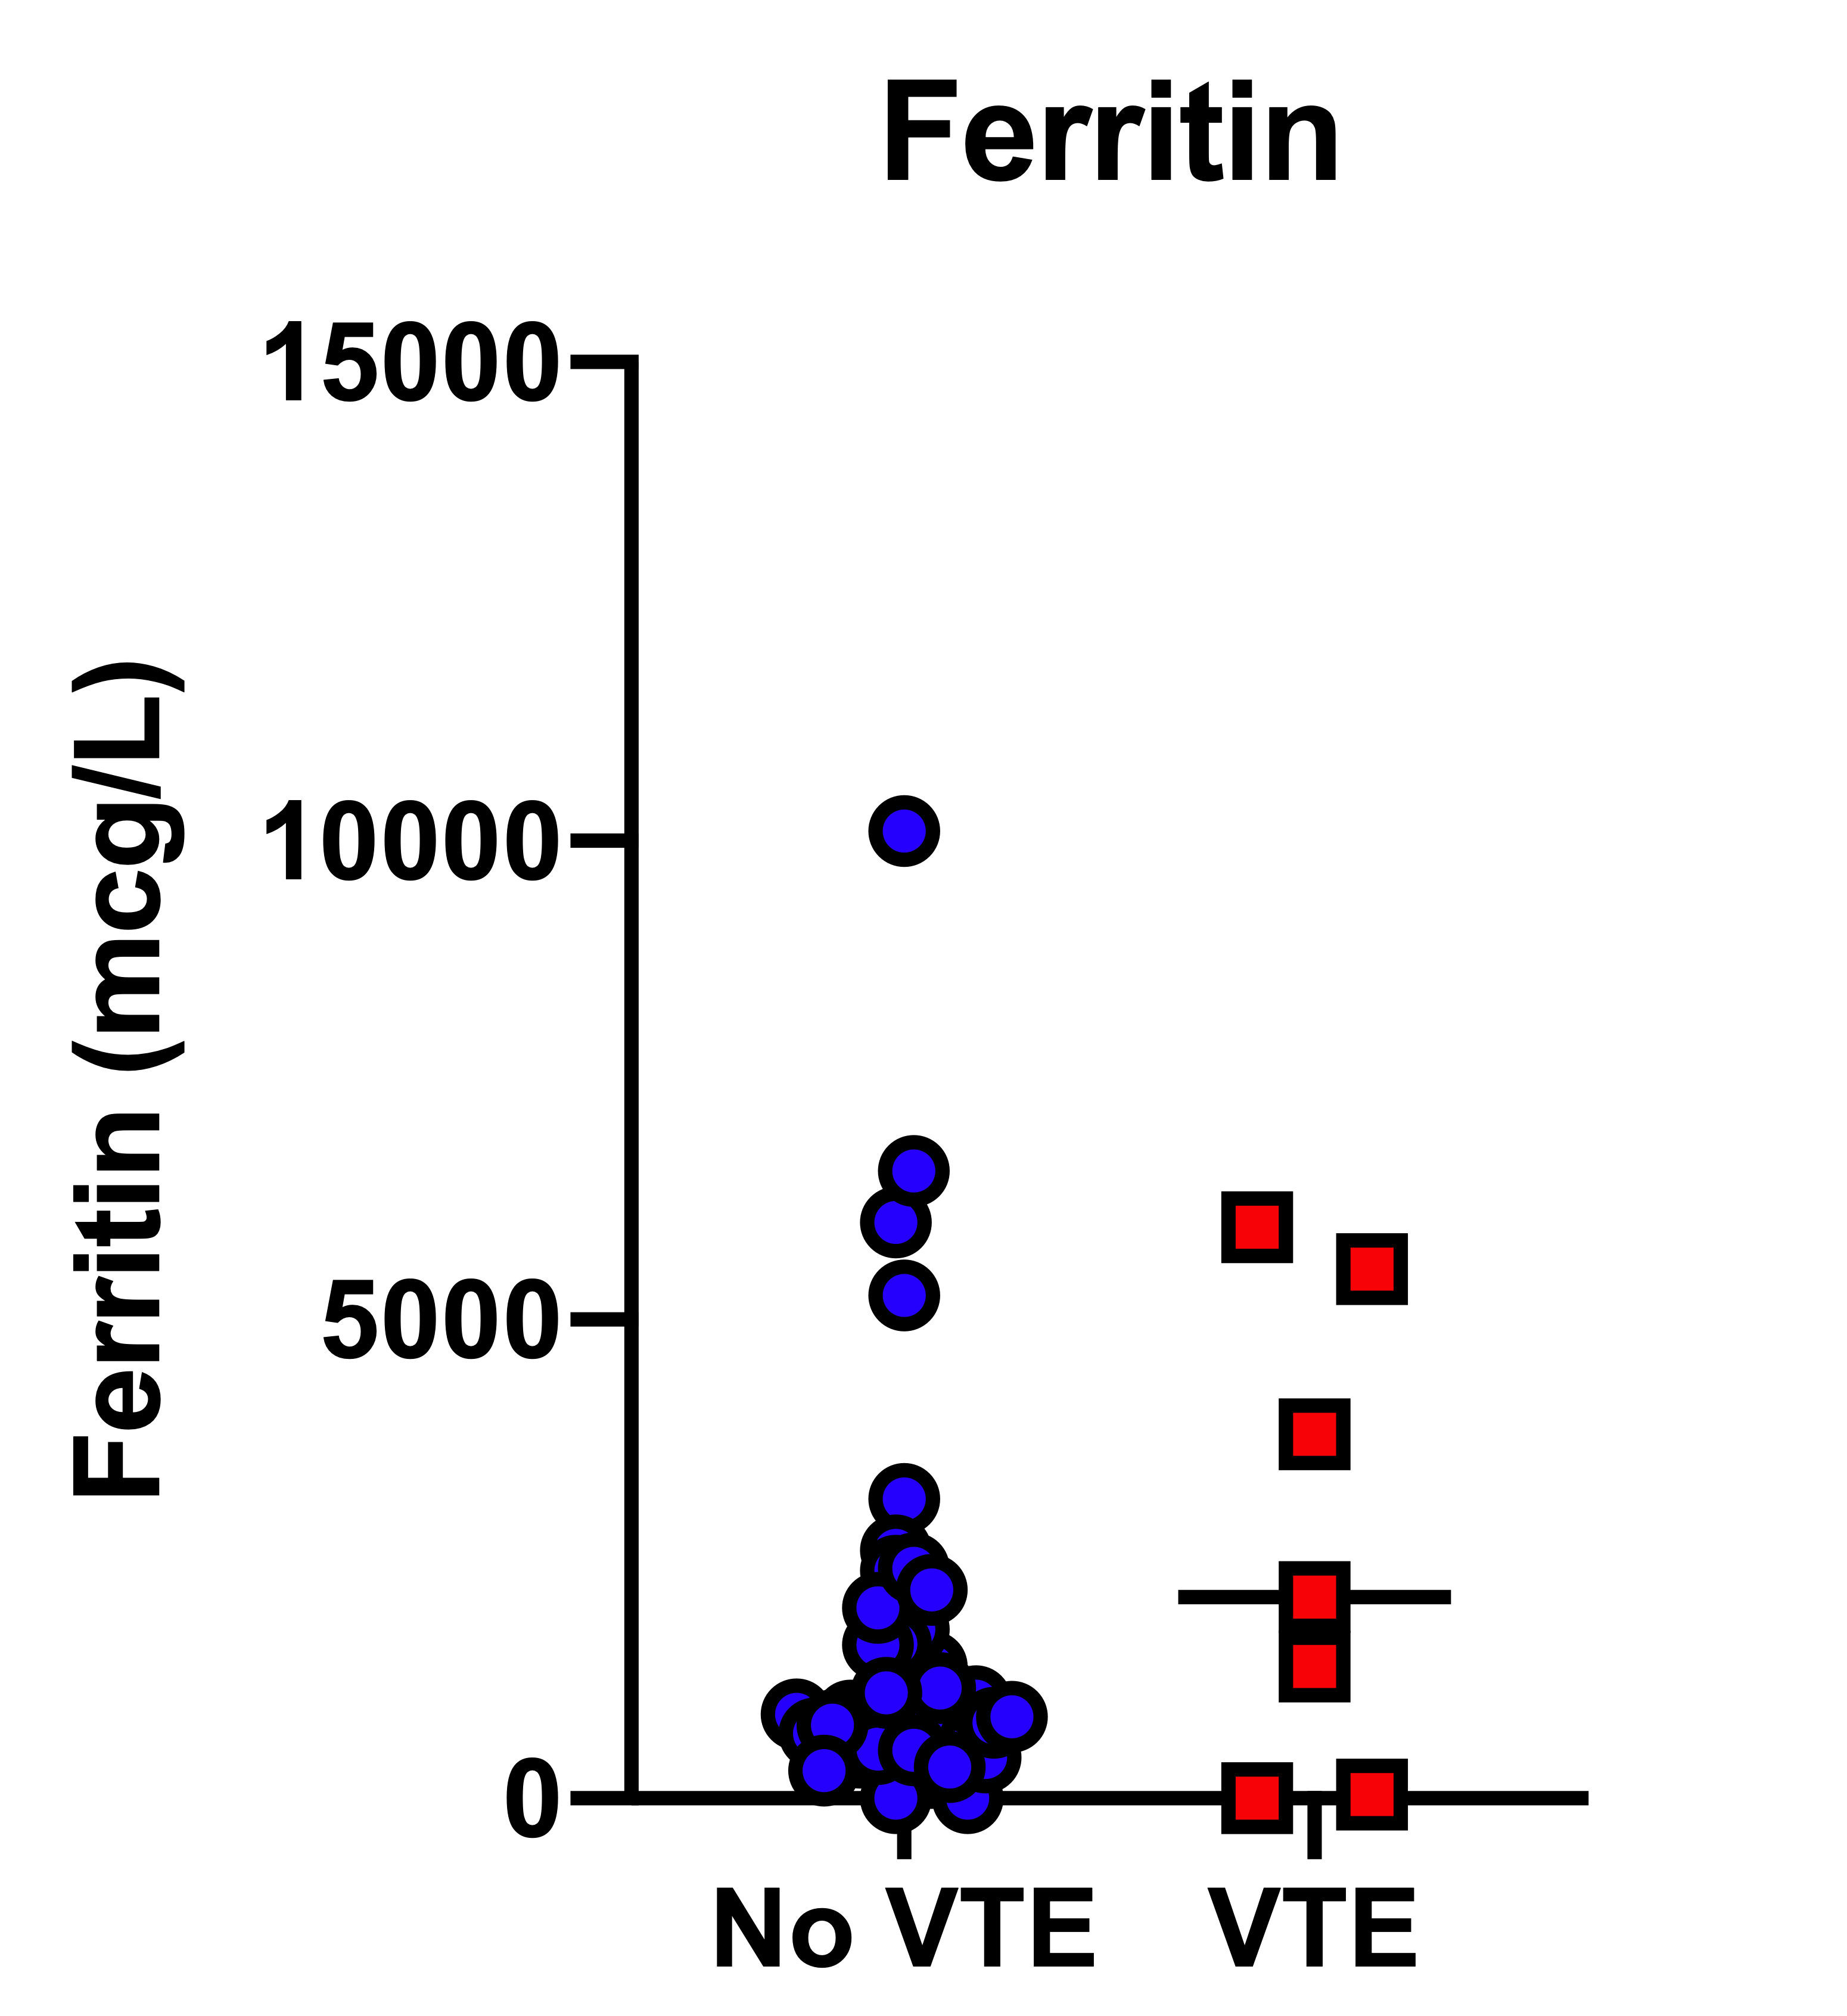
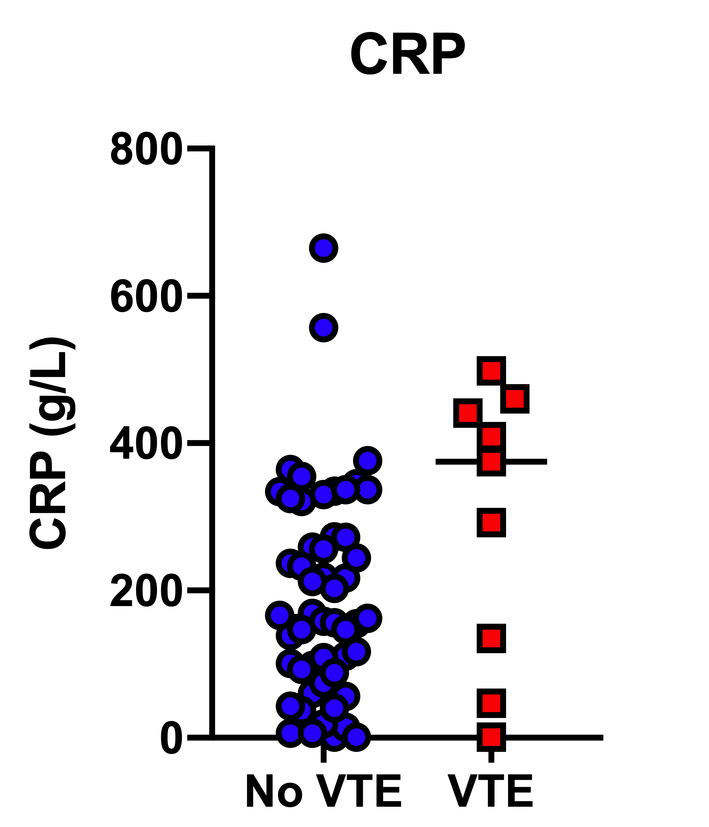
Coagulation & inflammatory markers in our first 66 ICU patients with COVID-19 March/April 2020 Desborough et al. Thrombosis Research
Dashed line is normal range

Slide 27
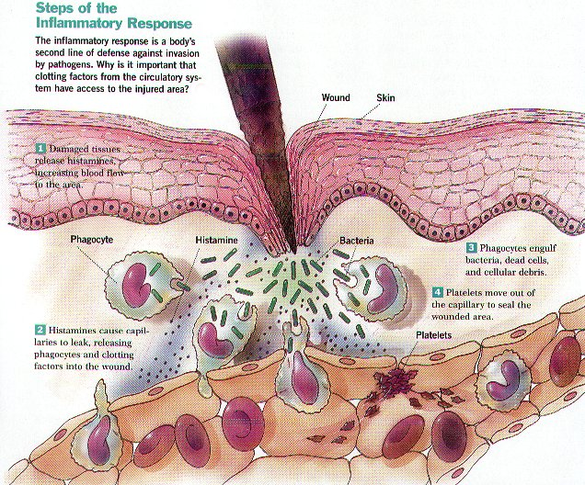
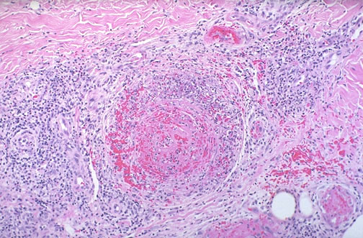
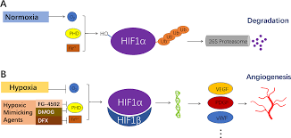
Concepts around haemostasis in sepsis, inflammation & hypoxia relevant to COVID-19 pneumonia
The coagulation system evolved as an effector
pathway of the immune response:
laying down fibrin around bacteria to physically entrap them
& prevent their dissemination
Thus the end point of inflammation is thrombosis
e.g Behcets disease, vasculitis
…and anticoagulants do not improve outcome in these states
Instead we treat the inflammatory process
Hypoxia → hypoxia- inducible transcription factors which
leads to a prothrombotic state (affect tissue factor & PAI-1 genes)

Slide 28
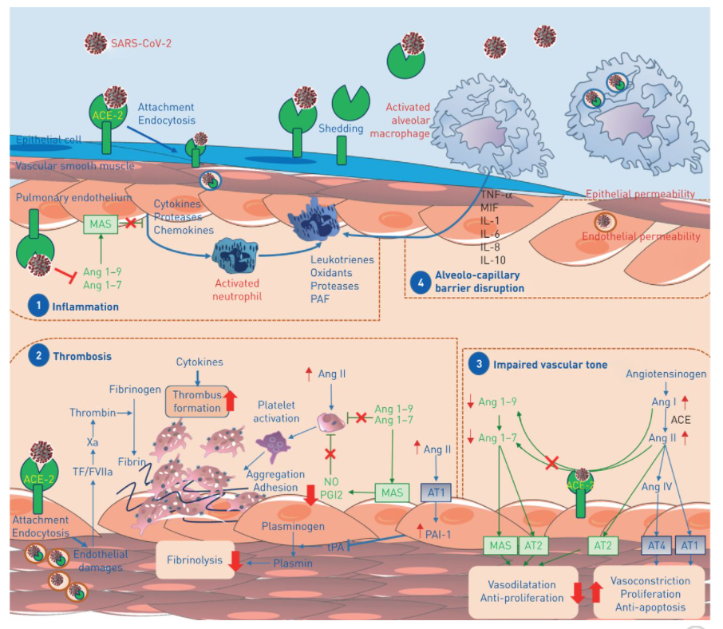
SARS-Co2 cause endothelial cell activation

Slide 29
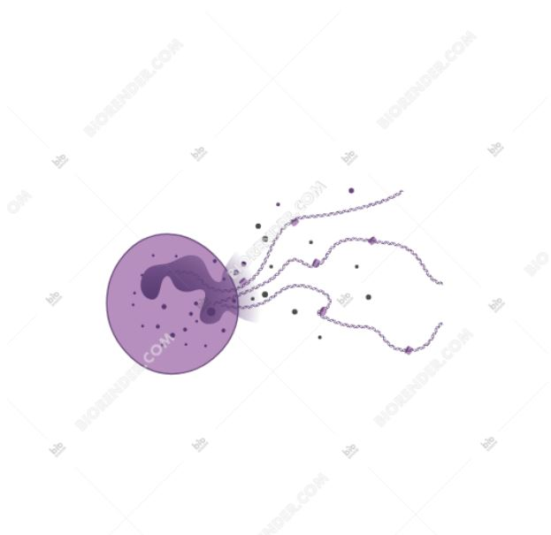
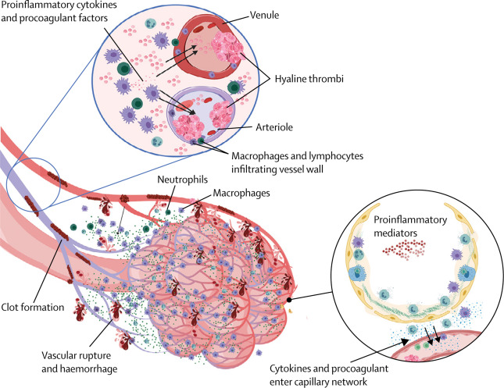
Immunothrombosis
Many prothrombotic
mechanisms such as NETOSIS
occur in COVID-19 pneumonia
Zou et al- cell free DNA
correlated with neutrophil count
& severity of disease
McGonagle et al. Lancet Rheumatology 2020; doi.org/10.1016/S2665-9913(20)30121-1

Slide 30
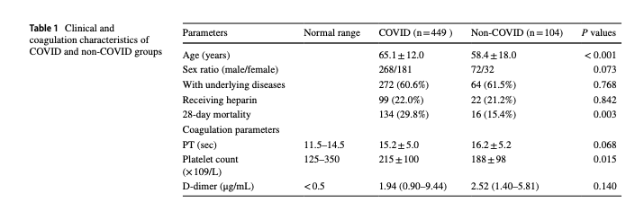
D-dimers are increased in inflammatory states, post operatively, pregnancy, going
for a run and in ….non COVID pneumonias
Taken from Yin et al J Thromb Thrombolysis 2020 on line 3 4 20

Slide 31
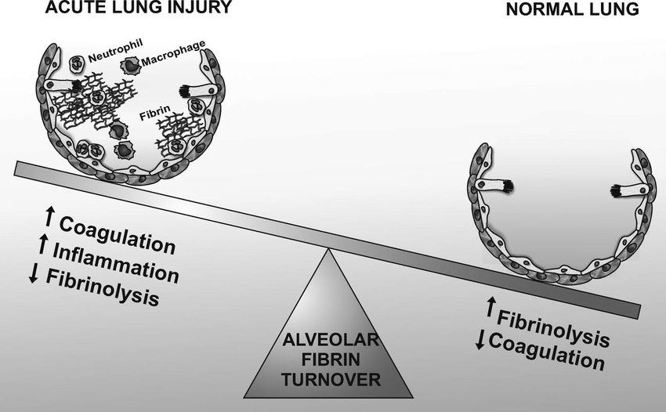
Why are D-Dimer levels ↑& prognostic in COVID-19? Hypothesis: a result of acute lung injury Hunt BJ & Levi M, Brit J Haematol 2020; 190: e133-34
The hallmark of acute lung injury is intra-alveolar fibrin deposition
(& later remodeling of fibrin → lung fibrosis)
Urokinase –type plasminogen activator (uPA) produced locally regulates extravascular proteolysis, inhibited by PAI-1
In SARS -infected mice a dose-dependent ↑ in lung urokinase with dose of SARS injected but locally swamped by PAI-1
Idell, Crit Care Med 2003:S213-20, Gralinski, mBIo 2013; 4:e00271-13

Slide 32
Pathogenesis of severe COVID-19 coagulopathy
It is a combination of:
It is not DIC (unless dying of hypoxia)
Acute phase response
Endothelial cell activation
Fibrinolytic shutdown & ↑ D-dimers (latter due to overspill from fibrinolysis in lung tissue?)
Fibrinogen levels are v high vs. low in DIC
APTT/PT tend to be normal vs. prolonged in DIC
Platelet count is normal vs. low in DIC

Slide 33
A comparison of thrombosis rates in patients with severe respiratory failure due to COVID-19 vs. influenza requiring extracorporeal membrane oxygenation Doyle, Hunt,Sanderson, Zhang, Mak, Breen, Camporata, Barrett, Retter Critical Care Medicine 2021 April 5th
Type | Influenza (n=80) | COVID-19 (n=51) | Significance (p-value)
All pulmonary artery filling defects seen at initiation of ECMO | 6 (8%) 2 - central 0 - lobar 4 - segmental 0 – subsegmental | 19 (37%) 2 - central 3 - lobar 5 - segmental 9 – subsegmental | 0.0001
Pulmonary Immunothrombosis at initiation of ECMO* | 4 (5%) | 14 (27%) | 0.0005
Intracranial haemorrhage present at initiation of ECMO | 11 (14%) 9 - Subarachnoid 2 - Intracerebral | 8 (16%) 7 - Subarachnoid 1 - Subdural | 0.759
Deep vein thrombosis seen on Doppler ultrasound at decannulation (n=99) | 15 (25%) | 20 (53%) | 0.005
* Pulmonary immunothrombosis considered as image-proven segmental and subsegmental filling defects

Slide 34
A comparison of thrombosis rates in patients with severe respiratory failure due to COVID-19 vs. influenza requiring extracorporeal membrane oxygenation Doyle, Hunt,Sanderson, Zhang, Mak, Breen, Camporata, Barrett, Retter Critical Care Medicine 2021 April 5th
Type | Influenza (n=80) | COVID-19 (n=51) | Significance (p-value)
All pulmonary artery filling defects seen at initiation of ECMO | 6 (8%) 2 - central 0 - lobar 4 - segmental 0 – subsegmental | 19 (37%) 2 - central 3 - lobar 5 - segmental 9 – subsegmental | 0.0001
Pulmonary Immunothrombosis at initiation of ECMO* | 4 (5%) | 14 (27%) | 0.0005
Intracranial haemorrhage present at initiation of ECMO | 11 (14%) 9 - Subarachnoid 2 - Intracerebral | 8 (16%) 7 - Subarachnoid 1 - Subdural | 0.759
Deep vein thrombosis seen on Doppler ultrasound at decannulation (n=99) | 15 (25%) | 20 (53%) | 0.005
COVID-19 produces the most prothrombotic state we have ever seen with a viral infection
* Pulmonary immunothrombosis considered as image-proven segmental and subsegmental filling defects

Slide 35
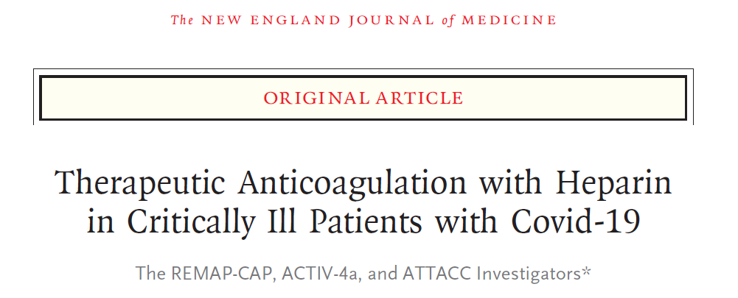
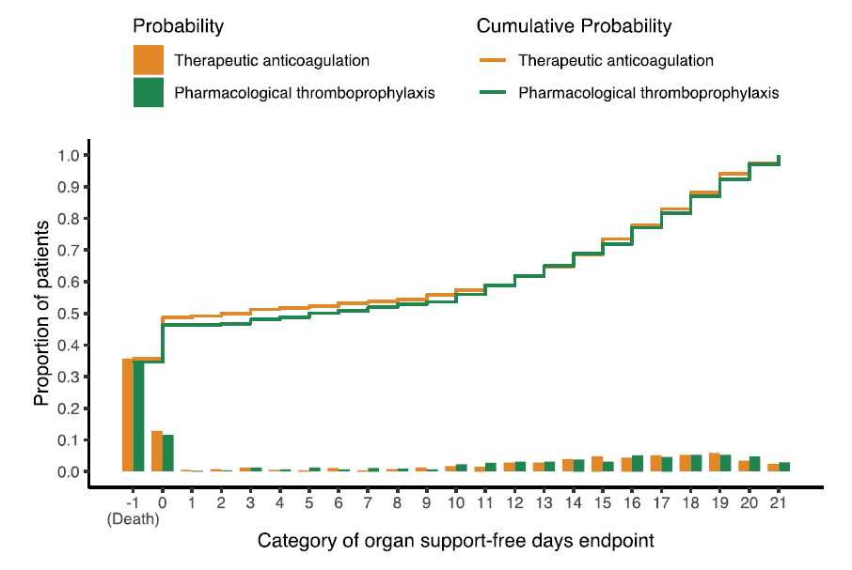
1074 pts
Median organ support-free days were 3 days
(interquartile range –1, 16) with therapeutic
anticoagulation & 5 days (interquartile range –1, 16)
With usual care thromboprophylaxis
(adjusted odds ratio 0.87,
95% credible interval (CrI) 0.70-1.08, post prob of
futility [odds ratio<1.2] 99.8%).
Hospital survival was comparable between groups
(64.3% vs. 65.3%, adjusted odds ratio 0.88,
95% CrI 0.67-1.16).
Major bleeding occurred in 3.1% therapeutic
anticoagulation and 2.4% usual care
thromboprophylaxis.

Slide 36
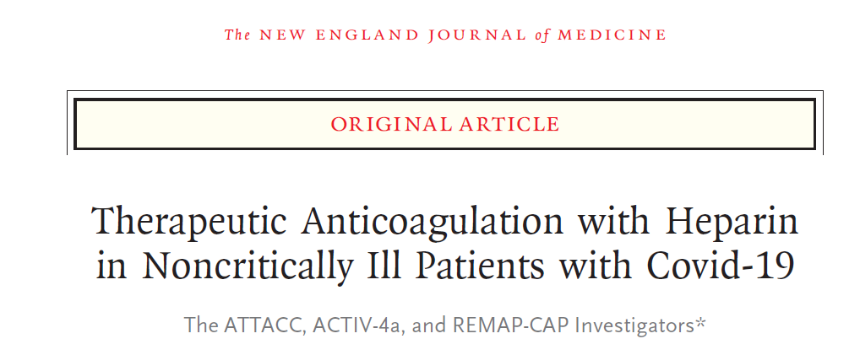
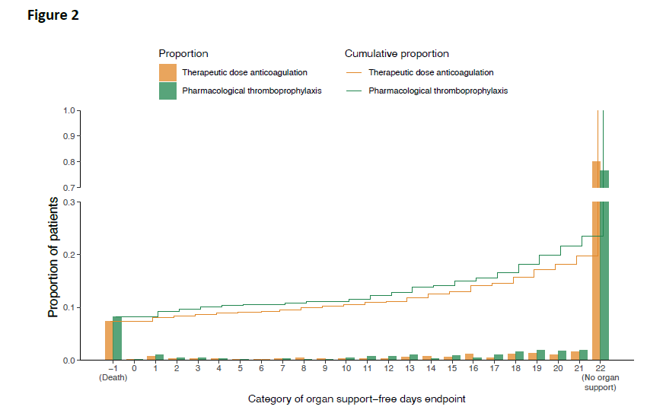
2219 pts
The probability that therapeutic anticoagulation increased
Organ support free days compared to “standard”
thromboprophylaxis was 99%
The increase in survival to hospital discharge was 4.6%
Major bleeding occurred in 1.9% of therapeutic &
0.9% of “standard” thromboprophylaxis

Slide 37
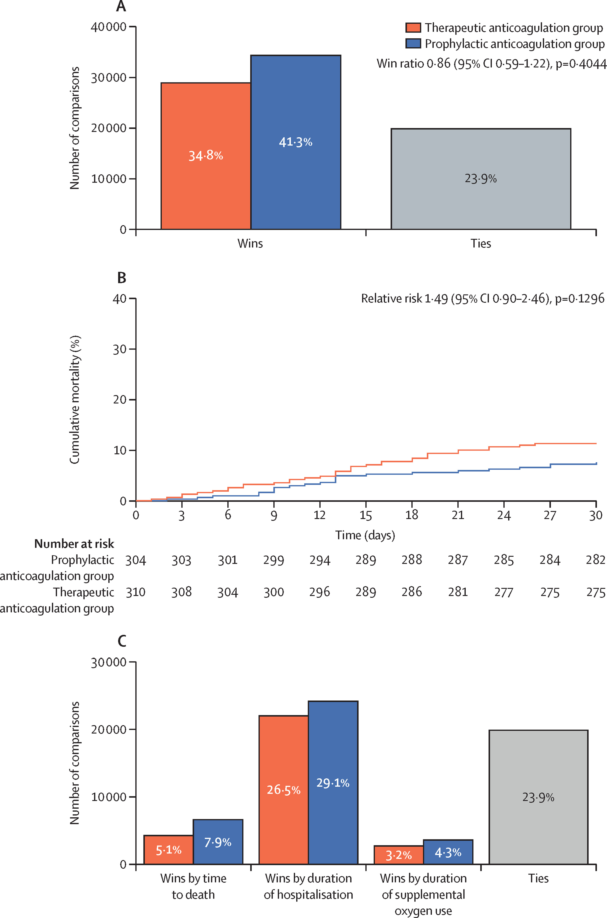
Therapeutic vs. prophylactic anticoagulation for patients admitted to hospital with COVID-19 & elevated D-dimer conc (ACTION): an open-label, multicenter RCTr Lopes et al, Lancet 2021; 397: 2253
Rivaroxaban 20mg for 30 days
Vs standard thromboprophylaxis
Minority had LMW or UFH
No benefit of therapeutic anticoagulation
The primary safety outcome of major or clinically relevant non-major bleeding occurred in
-26 (8%) patients assigned therapeutic anticoagulation and
7 (2%) assigned prophylactic anticoagulation
(relative risk 3·64 [95% CI 1·61–8·27], p=0·0010).

Slide 38
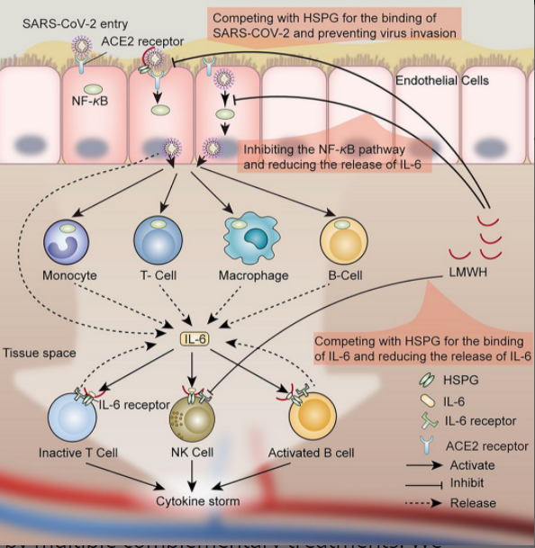
Full dose heparin NOT DOACs clinically beneficial in moderate COVID-19, but not explained by antithrombotic effect, possibly anti-inflammatory effect?
Taken fr Chen S et al CTS 2020; 13: 1087

Slide 39
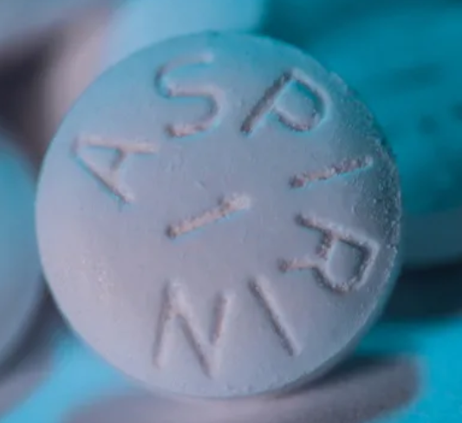
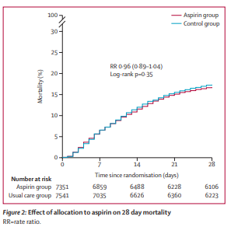
Aspirin use in the RECOVERY trial Lancet 2022;399:149-51
7351 pts randomised to aspirin 150 mg once daily & compared with 7541 patients randomised to usual care alone.
There was no evidence that aspirin treatment reduced mortality.
There was no significant difference in the primary endpoint of 28-day mortality (17% aspirin vs. 17% usual care; rate ratio 0.96 [95% confidence interval 0.89-1.04]; p=0.35).
The results were consistent in all pre-specified subgroups of patients.
For every 1000 patients treated with aspirin, approximately 6 more pts experienced a major bleeding event and approximately 6 fewer experienced a thromboembolic event.

Slide 40
Summary of anticoagulation & antiplatelet agents use in severe COVID-19 August 2022
Use standard LMWH thromboprophylaxis in critical care
Consider full-dose LMWH in moderate/ward patients
Additional antiplatelet agent of no benefit

Slide 41
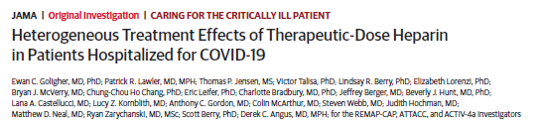
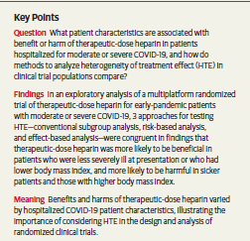

Slide 42
‘Unprecedented achievement’: who received the first billion COVID vaccinations?
It took just four months to reach this global milestone
“It is an unprecedented scientific achievement. Nobody could have imagined that,
within 16 months of the identification of a new virus, we would have vaccinated
one billion people worldwide with a variety of different vaccines, using different
platforms and made in different countries,” says Soumya Swaminathan,
the WHO’s chief scientist, based in Geneva, Switzerland.
A Nepalese man receives a COVID-19 vaccine at Lukla near Mount Everest in the Himalayas.
‘As of 27 April, 1.06 billion doses had been given to 570 million people, which means that about 7.3% of the world’s
population of 7.79 billion have received at least one dose. But scientists say that more than 75% of the world’s population
will need to be vaccinated to bring the pandemic under control’.
Freda Kreier, Nature, 29th April 2021

Slide 43
Post Vaccine Induced immune Thrombocytopenia & Thrombosis (VITT) cases
38 year old
Vaccinated A-Z
14 days later had a severe headache with GCS14.
MRI venogram shows CVST
PLt 16, D-dimer 6,000
Fibrinogen 0.6g/l
Admitted
Rxed but developed massive ICH
Brain stem death
41 year old man
Vaccinated A-Z
6 days later presents with ischaemic legs
Plt 42, D-dimer 8,000
Fib 1.9
Given IV IgG and argatroban
Back to theatre x 2

Slide 44
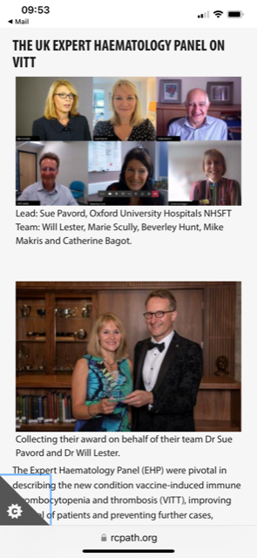
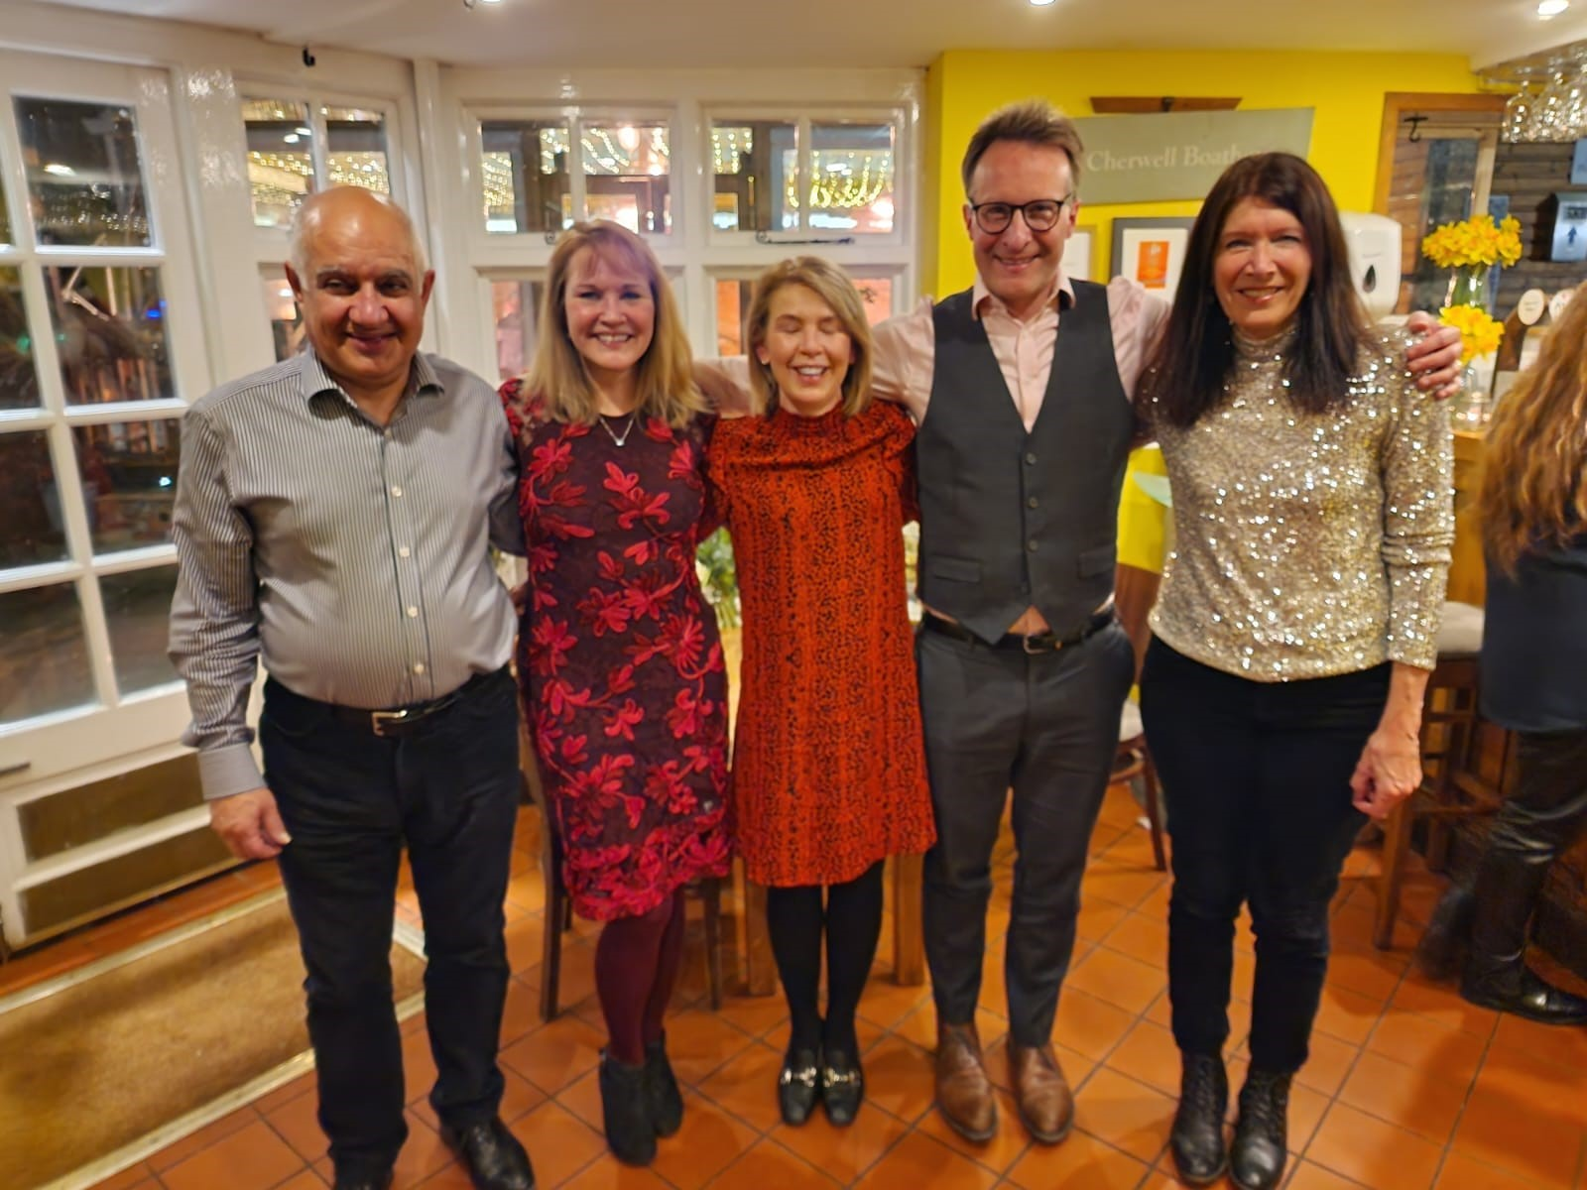
UK Haematology thrombosis experts group for VITT
Mid March 2021 formed a group that met virtually daily at 2.00- 3.00
Present new cases, reviewing old and developing living guidance
Worked closely with Public Health England & devolved nations & MHRA to pool data
Active research E.g. did we missed cases? We used A-Z since 30th Dec but the syndrome only recognised mid March so looked back at cases of thrombosis & thrombocytopenia from Jan-mid March
Talking to other medical groups e.g Emergency Medicine who were overwhelmed with headaches post A-Z after first press release
Our guidance on BSH website was converted to NICE guidelines

Slide 45
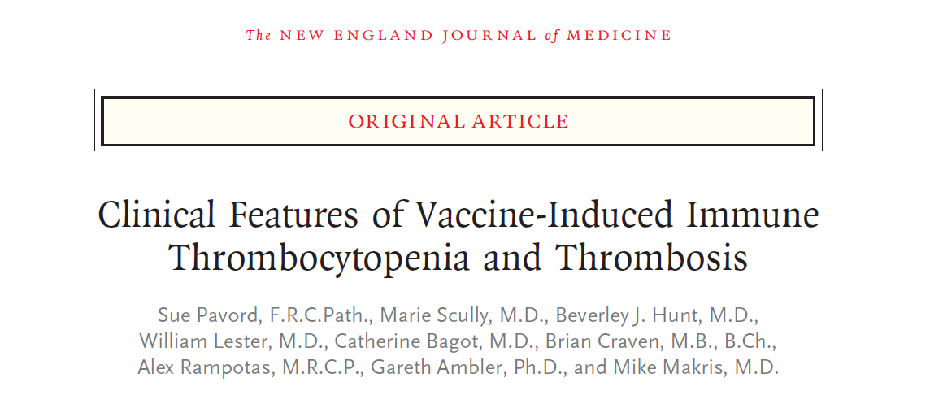



Slide 46
Current analysis of first 294 patients
294 patients, 252 were suspected VITT, with 220 confirmed definite or probable cases.
Except three cases, all followed the 1st ChAdOx1 nCoV-19 vaccine, presenting 5-48 (median 14) days post vaccination.
Age range 18-79 (median 48) years, with no sex preponderance and NO identifiable medical risk factors.
Overall mortality was 22%.
Cerebral venous sinus thrombosis (CVST), the commonest thrombosis, mortality was 33%, increasing to 73% when associated with intracranial haemorrhage (ICH) & plt <30.
Arterial thrombosis occurred in 12%, was associated with 35% mortality.
Laboratory indicators for mortality were platelet count (p<0.001), D dimers and reduced fibrinogen (p= <0.05). Mortality was 46% if platelets <30×10⁹/L (OR 2.6) increasing to 83% with ICH (OR 6.4).
NO OBVIOUS PREDISPOSING FACTORS

Slide 47


Pathophysiology of heparin –induced thrombocytopenia
Platelet factor 4
i.e heparin is acting as a hapten
70 amino-acid protein
Released from alpha-granules
of activated platelets opsin for
negatively- charged bacteria surfaces
Binds with high affinity to
heparin & inhibits it.

Slide 48


Taken from Greinacher et al
https://www.researchsquare.com/article/rs-440461/v1
Figure 1. Interaction of PF4 with the vaccine. A) Hydrodynamic diameter of ChAdOx1 nCoV-19 vaccine (1:10 dilution in 0.9% NaCl, 0.4 mg/mL saccharose) was increased by the addition of PF4 (10 µg/mL). Addition of an anti-PF4 monoclonal antibody (Clone RTO) or affinity-purified anti-PF4 IgG from VITT patient sera further increased hydrodynamic diameters of vaccine components. The largest complexes were formed in the presence of DNA. Addition of heparin (100 IU/mL) dissociated formed complexes. B) 3D-super-resolution microscopy shows binding of PF4 (green) to clusters of proteins of the ChAdOx1 virus (purple; upper left). Particle-/PF4 interaction was analyzed in 8005 aggregates of 4 individual images; 80.6% of particles stained positive for PF4. Upper right, adenoviral protein positive particles (purple) bound to platelets (green). Mean viral density of 1.7 stained particles per platelet. Platelets were incubated with 10 µg/mL PF4 or 1:10 diluted ChAdOx1 nCoV-19 vaccine. Scale: 1 µm. (Further details are given in supplementary material) C) -E) Electron micrograph of aggregates in the vaccine after addition of PF4; D) aggregates (arrowhead) formed in the vaccine after addition of PF4. The adenovirus capsid protein is labelled. E) aggregates (arrowhead) formed in the vaccine after addition of PF4. Now the biotinylated PF4 is labelled with 10 nm gold particles (arrow):, Bars: 100 nm each.
Taken from Toh C-H et al. clinical Medicine 2022; 22: 140-4

Slide 49

Better platelet recovery with plasma exchange post VITT taken from Craven B et al. Blood 2022; 139: 2553-2560

Slide 50


Natural history of PF4 antibodies Craven et al. Blood 2022; 139: 2553-2560
72% still positive day 100
Relapse rate 12.6% <90 days, all thrombocytopenia, one clot extension

Slide 51

Further studies have shown the epitope on platelet factor -4 is different between VITT and HITT

Slide 52

Risk of VITT is 1:50,000-100,00 with Astra-Zeneca
Vaccine
In the UK we no longer use this vaccine
J & J vaccine also adenoviral derived it not used
In USA
But A-Z is still the most widely used vaccine globally
But this is not the end of the story…

Slide 53


Test Results in Two Patients with Vaccine-Induced Immune Thrombotic Thrombocytopenia (VITT)–like Anti–Platelet Factor 4 (PF4) Disorder Associated with Adenovirus Infection.
“Spontaneous VITT
TE Warkentin et al. N Engl J Med 2023;389:574-577.
Notes:
Figure 1. Test Results in Two Patients with Vaccine-Induced Immune Thrombotic Thrombocytopenia (VITT)–like Anti–Platelet Factor 4 (PF4) Disorder Associated with Adenovirus Infection. Panel A shows clinical data (serial platelet counts and coagulation tests [prothrombin time, fibrinogen, and D-dimer]) from Patient 1 (a 5-year-old boy) and Patient 2 (a 58-year-old woman) in relation to clinical events. Reference ranges are in parentheses. Asterisks after the values for prothrombin time indicate concurrent anticoagulation with bivalirudin (in Patient 1) or argatroban (in Patient 2). Under “samples tested” for Patient 1, the dagger symbol indicates that the serum sample was obtained post mortem. Testing for hypercoagulability disorders in Patient 1 identified a heterozygous factor V Leiden (R506Q) mutation; all other investigations (lupus anticoagulant, anticardiolipin and anti-β₂-glycoprotein-I IgG and IgM antibodies, prothrombin 20210 gene mutation, ADAMTS13 activity level, and paroxysmal nocturnal hemoglobinuria peripheral-blood flow cytometry) yielded normal or negative results. The results of severe acute respiratory syndrome coronavirus 2 (SARS-CoV-2) antibody testing were consistent with a known history of mild SARS-CoV-2 infection 16 months earlier. Testing for hypercoagulability disorders in Patient 2 yielded normal or negative results for factor V Leiden and prothrombin 20210 gene mutations; lupus anticoagulant; anticardiolipin and anti–β₂-glycoprotein I IgG and IgM antibodies; paroxysmal nocturnal hemoglobinuria; ADAMT13 activity; JAK2 V617F, CALR, and MPL mutations; and antinuclear antibodies. Patient 2 had been vaccinated against coronavirus disease 2019 15 months earlier (two messenger RNA [Moderna] doses). Patient 1 (body weight, 20.2 kg; height, 112 cm) received a single 20-g dose of intravenous immune globulin (IVIG, Privigen), and Patient 2 (body weight, 92 kg; height, 168 cm) received IVIG (Gamunex-C) on two consecutive days (50 g on the first day and 55 g on the following day); replacement fluid for therapeutic plasma exchange in Patient 2 was 5% albumin (4600 ml on the first day and 4000 ml on the second day). Panel B shows serologic data from two solid-phase enzyme-linked immunosorbent assays (ELISAs) and an IgG-specific chemiluminescence immunoassay (CLIA-IgG); an IgG-specific fluid-phase ELISA (testing against PF4 alone and PF4–heparin complexes); and a platelet-activation assay (the serotonin-release assay). Reference ranges are shown in parentheses. All the data from the controls (serum samples from patients with classic heparin-induced thrombocytopenia [HIT], autoimmune HIT, and VITT and from a patient with spontaneous HIT with cerebral venous sinus thrombosis and VITT-like antibodies³) showed the expected reactions (data not shown). Panel C shows the findings from anti-PF4 epitope mapping. Shown in red are the amino acids on PF4, representing the binding sites of the antibodies to PF4 that were observed in Patients 1 and 2; these amino acids correspond to amino acids that had been reported as being recognized by VITT antibodies.² Serum samples from both patients contained antibodies to PF4 that bound to a region on PF4, the location of which aligns with that shown in a previous study² and corresponds approximately to the heparin-binding region on PF4. Both patients had an additional amino acid at R20 (underlined) that had not previously been recognized as part of the VITT antibody epitope²; this epitope is located in the heparin-binding region on PF4. Patient 2 had an additional amino acid at K65 (underlined) that had not previously been recognized as part of the VITT antibody epitope²; this epitope is also located in the heparin-binding region on PF4. CLIA-IgG denotes IgG-specific chemiluminescence immunoassay, CVST cerebral venous sinus thrombosis, DVT deep-vein thrombosis, IV.3 platelet Fc receptor–blocking monoclonal antibody, OD optical density, PCR polymerase chain reaction, PF4–heparin ELISA-IgG IgG-specific ELISA for antibodies to PF4–heparin, PF4–PVS ELISA-IgGAM polyspecific (IgG/IgA/IgM) ELISA for antibodies to PF4–polyvinyl sulfonate, STEMI ST-segment elevation myocardial infarction, and SVT superficial-vein thrombosis.

Slide 54



Slide 55
In summary: thromboinflammation
Immunothrombosis
The effect of the immune response on coagulation
Antibody-mediated thrombosis
Thromboinflammation
The effects of haemostasis on inflammation

