Slide 1
Our Experience on Immersed Boundary Method
on Unstructured Meshes
Natalia Zhdanova
Keldysh Institute of Applied Mathematics RAS, Moscow, Russia

Slide 2
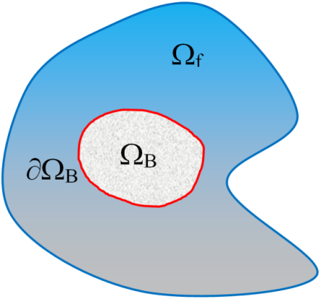
IMMERSED BOUNDARY METHOD
Theory
Incompressible Navier-Stokes Equations (NSE)
- solid body
- fluid region
- solid body surface
The classical problem setup
Dirichlet IBVP for NSE
Brinkman penalization method
IBVP is replaced with Cauchy problem for Modified NSE (MNSE)
Cauchy problem for MNSE
Theoretical solution estimation:
(Angot, 1999)

Slide 3
IMMERSED BOUNDARY METHOD
Theory
Extension to NSE for compressible flow
subsonic flows
For transonic and supersonic flows
”Pseudoporous media” model
(in physical variables)
Boiron O., et al. (Comp.&Fluids, 2009)
Abgrall R., et al. (JCP, 2014)
Liu Q., Vasilyev O.V. (JCP, 2008)
Komatsu R., et al. (Comp.&Fluids, 2016)

Slide 4
IMMERSED BOUNDARY METHOD
Theory
Extension to NSE for compressible flow and Neumann BC
Characteristic Based Volume Penalization Method (CBVPM)
Brown-Dymkoski E., Kasimov N., Vasilyev O.V. (JCP, 2014)
General treatment to penalization
Relaxation approach:
for Dirichlet BC
Characteristic transport along the inward normal to the boundary n:
for Newmann BC
Implementation to NSE
Adiabatic wall (modification of specific internal energy equation):
Artificial BC on the wall for density (modification of continuity equation):
An additional equation (to NSE) is needed to determine Φ:

Slide 5
Test Problems
Turbulent flow over a 3D circular cylinder at Re=3900
Flow induced by forced oscillations of a 2D cylinder at Re=100
In-line moving sphere
Flow over an oscillating 2D cylinder at Re=100
Pitching and plunging airfoil at Re=20000
Sound Generated in Flow Past a Oscillating Circular Cylinder
Acoustic Scattering on 2D Cylinder
Acoustic Scattering on Sphere

Slide 6
Some Numerical Results

Slide 7
NUMERICAL RESULTS
Moving Bodies
Flow over an oscillating cylinder y(t) = F(C_{D})
Pitching and plunging airfoil
Flow induced by forced oscillations of a sphere

Slide 8
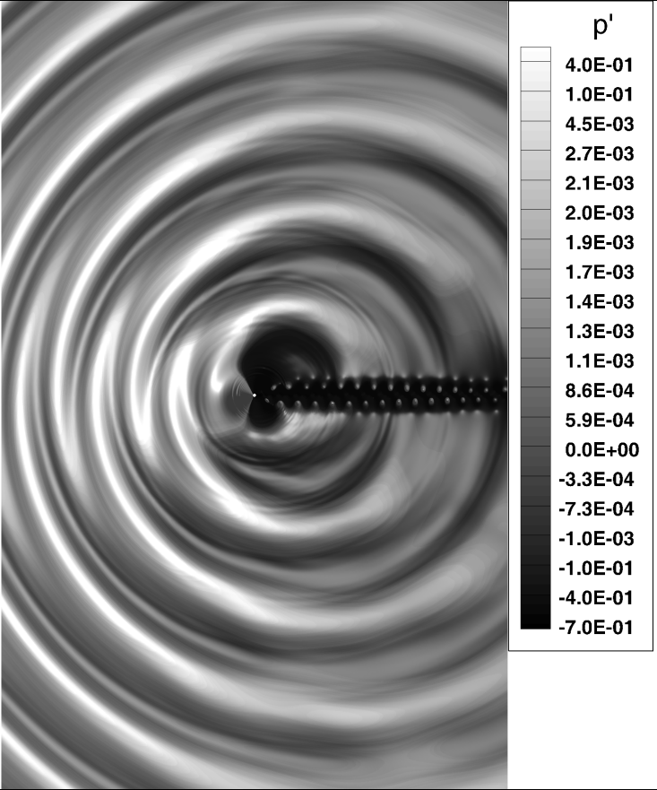
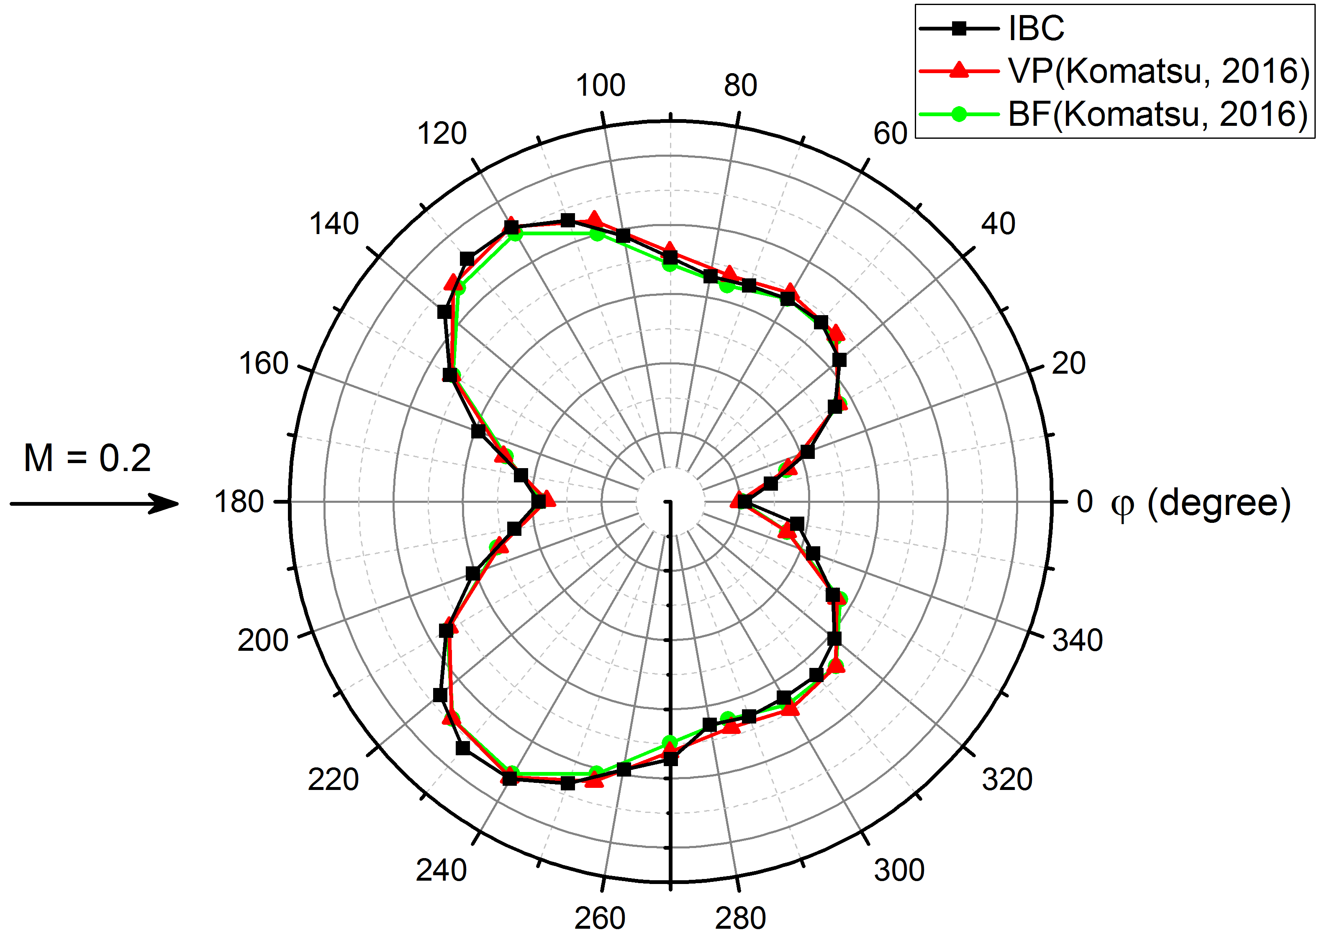
NUMERICAL RESULTS
Moving Bodies
Sound generated in flow past a oscillating circular cylinder
Distribution of pressure pulsations p’
Directivity of sound at R = 80:

Slide 9
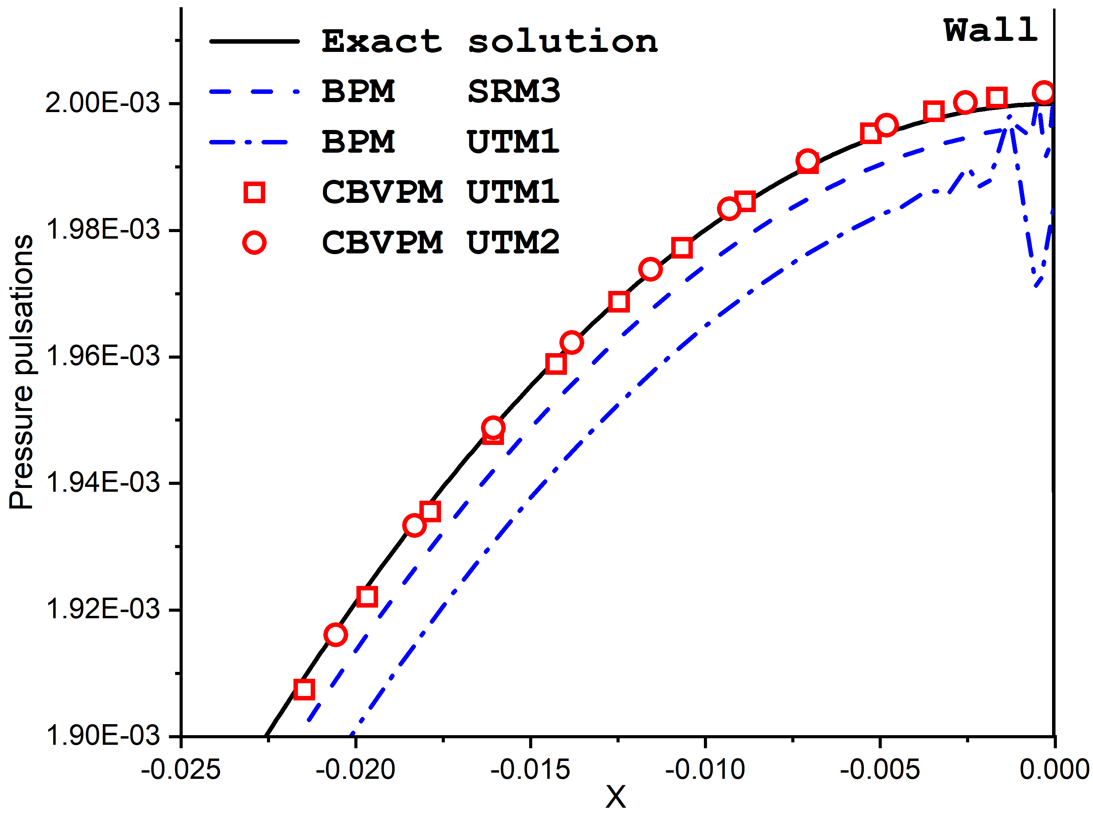
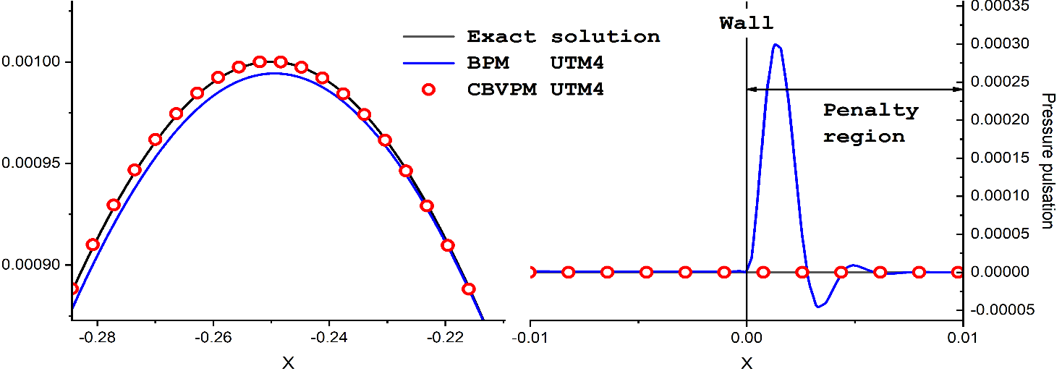
NUMERICAL RESULTS
Acoustic wave reflection
Pressure pulsations near the wall at the reflection time
Pressure pulsations of the reflected wave in the region of the pulsation maximum

Slide 10
Conclusions
1. Brinkman penalization: subsonic compressible flows, Dirichlet boundary condition.
2. Brinkman penalization with pseudoporous media model: trans- and super- sonic compressible flows, Dirichlet boundary condition.
3. Characteristic based volume penalization: compressible flows, Dirichlet and Newmann boundary condition.

