Slide 1
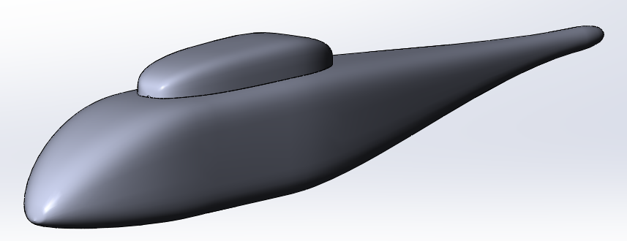
The RANS simulation of turbulent flow near helicopter fuselage using the body-fitted approach
Vladimir G. Bobkov
Vladislav V. Vershkov
NORMA Progress Meeting, April 20th , 2021

Slide 2
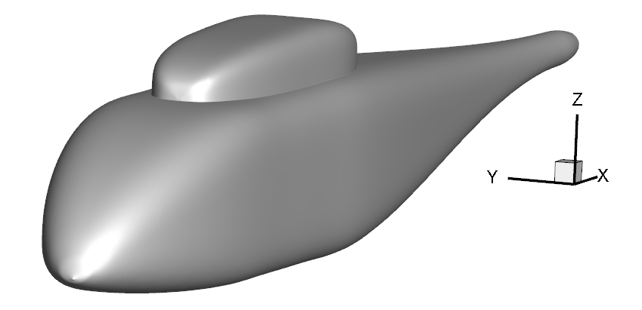
Problem formulation
ROBIN (ROtor Body INteractions) fuselage
Length = 3.15 m
α = β = 0
V∞ = 40 m/s
Re = 4·10⁶
V∞
NORMA Progress Meeting, April 20th , 2021

Slide 3
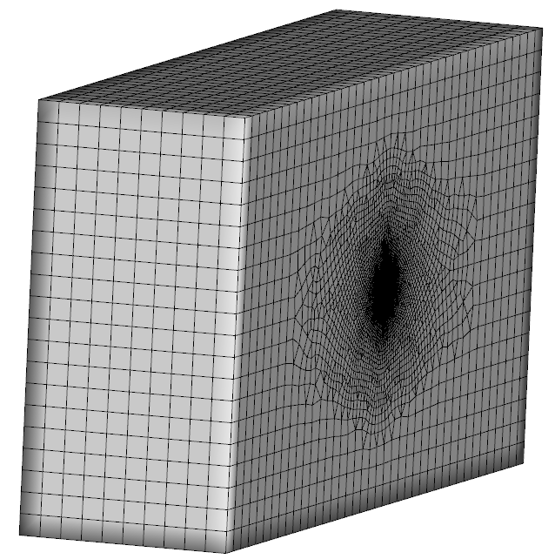
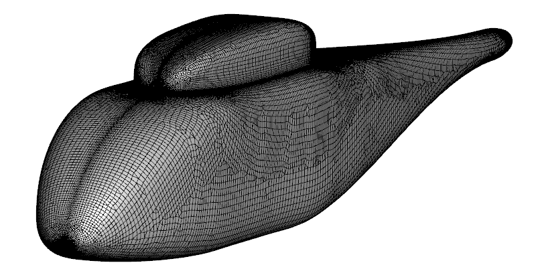
Mathematical model & Meshing
RANS with SA turbulent model
Implicit scheme (2nd time order)
WENO 5
Boundary conditions:
Input/ Output
No-slip wall
Symmetry
Physical computation time: 4 s
Domain size: 629.6 X 157.4 X 314.8 m
Nodes number 1.6 M per ½ of computation domain
Minimal tetrahedron height: 1.73·10⁻⁶
NORMA Progress Meeting, April 20th , 2021

Slide 4
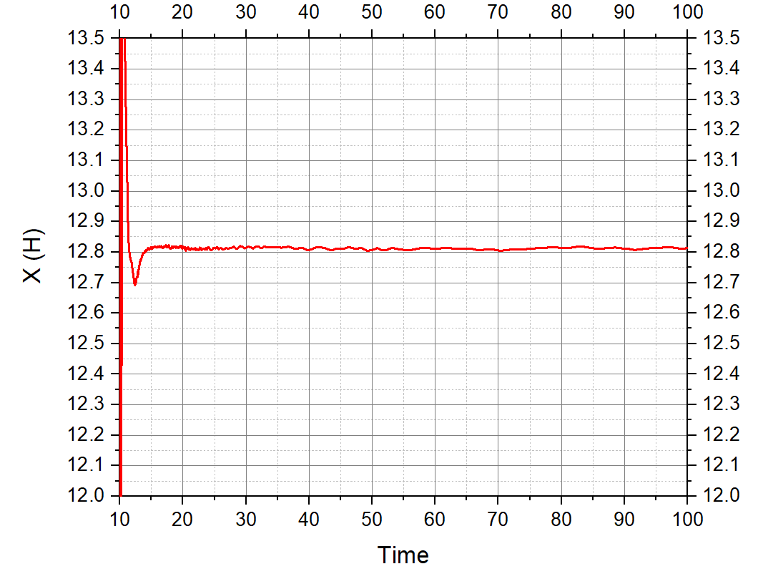
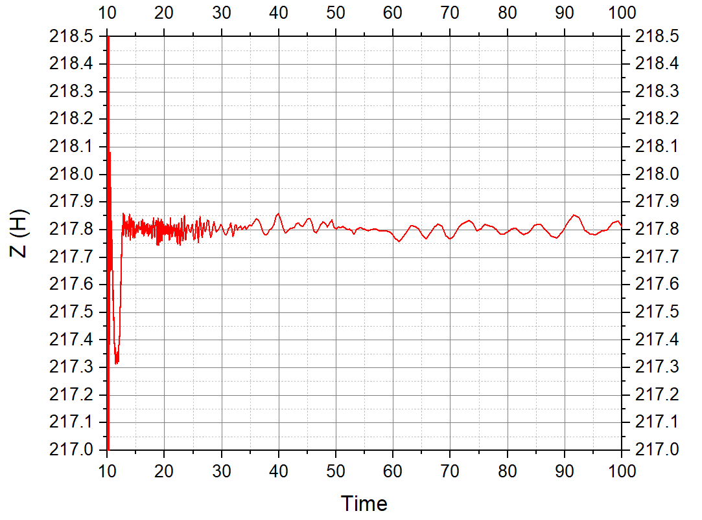
Results. Convergence
NORMA Progress Meeting, April 20th , 2021

Slide 5
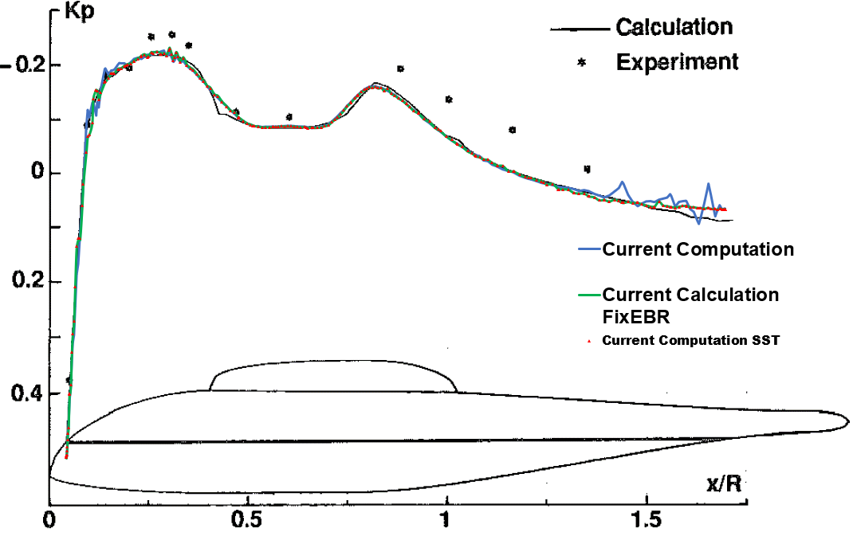
Results. Comparing with experiment
 | X[N] | Z[N]
Current Computation | 12.81 | 217.8
Current Computation Fixed EBR | 12.36 | 218.9
Current Computation SST | 12.61 | 219.1
*EXPERIMENTAL AND THEORETICAL STUDIES OF HELICOPTER ROTOR-FUSELAGE INTERACTION
N. Bettschart, A. Desopper, R. Hanotel and R. Larguier
ICAS-92-4.8.1
NORMA Progress Meeting, April 20th , 2021

Slide 6
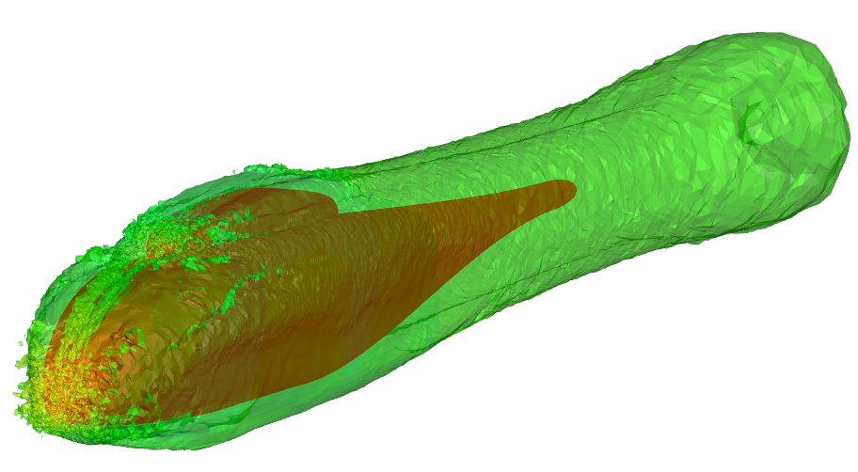
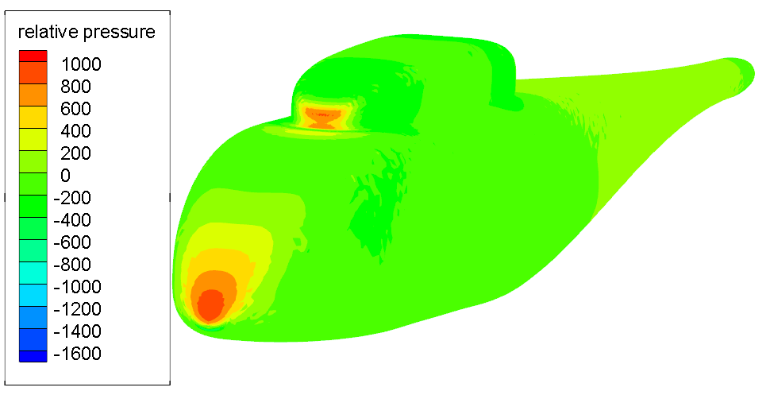
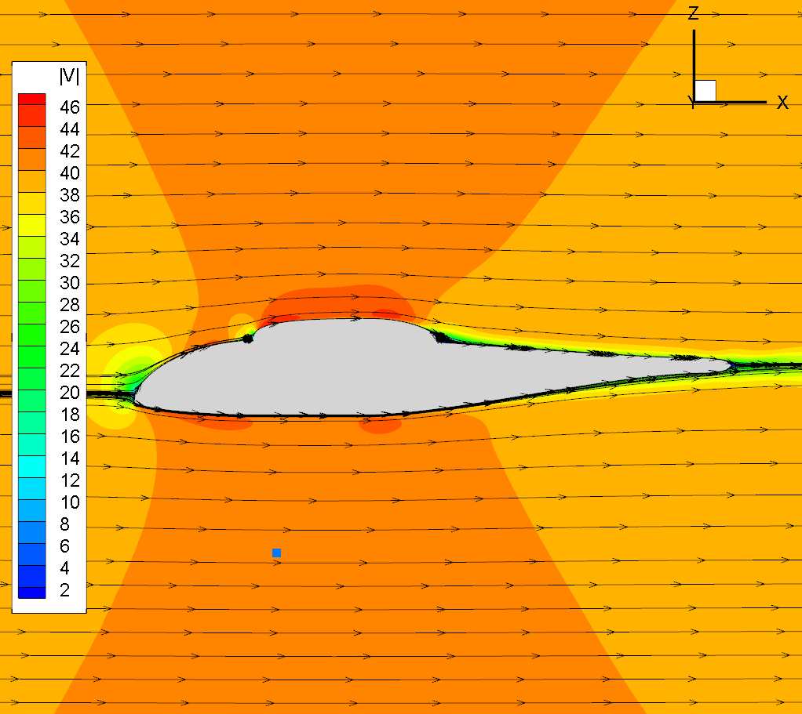
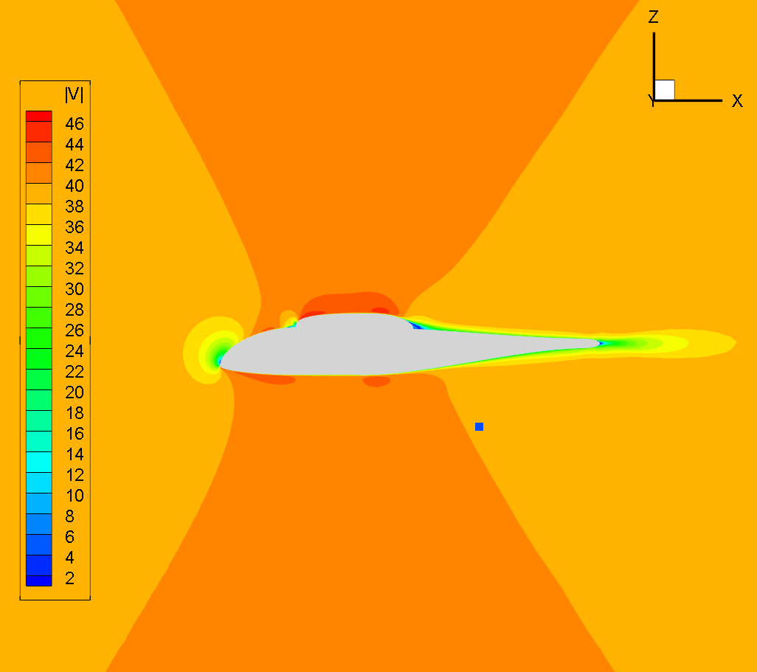
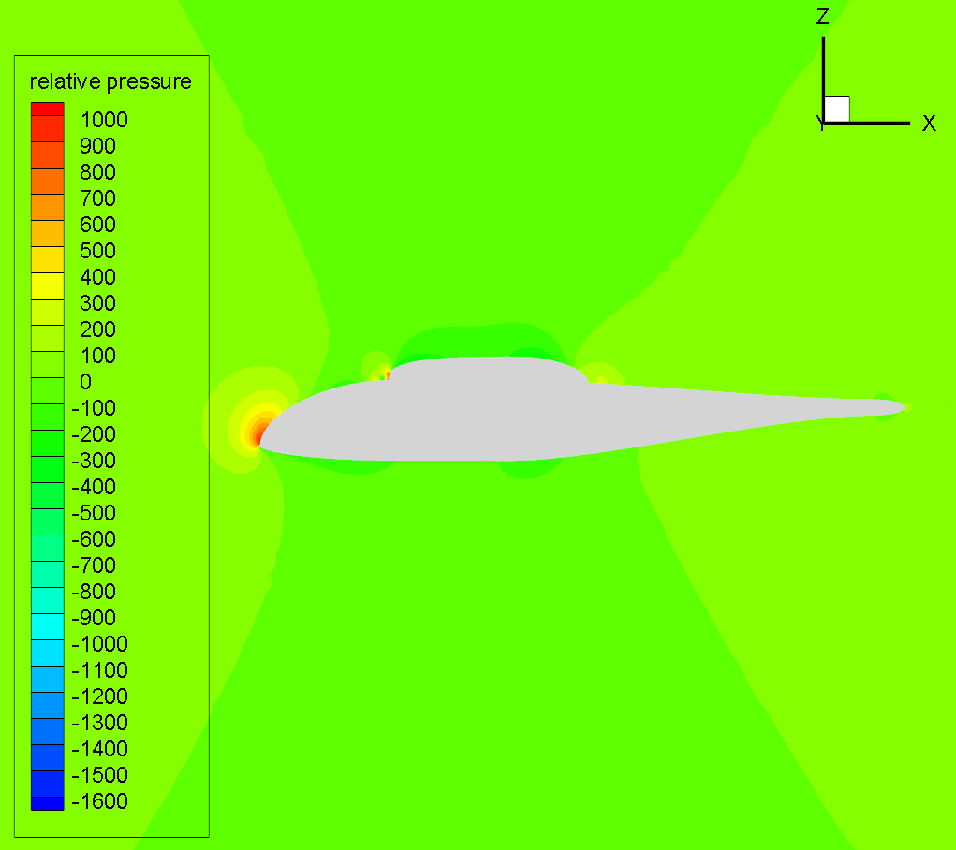
Results. Fields visualization
NORMA Progress Meeting, April 20th , 2021

Slide 7
Thanks you for the attention
NORMA Progress Meeting, April 20th , 2021

